Slide 1
Attractors of n=5 motif equivalence class (mEC) representatives
Dynamic attractors pooled across 103 mECs representing 1053 graphs.
For the CTLN parameters eps = .51, delta = 1.76 we identified 145 dynamic attractors by pooling together distinct attractors within each mEC.
We also include three “special attractors” at the end for different parameters.
Created by Carina Curto and Katherine Morrison (PIs) in collaboration with Caitlyn Parmelee, Sumita Garai, and Joshua Paik. August 16, 2020.

Slide 2
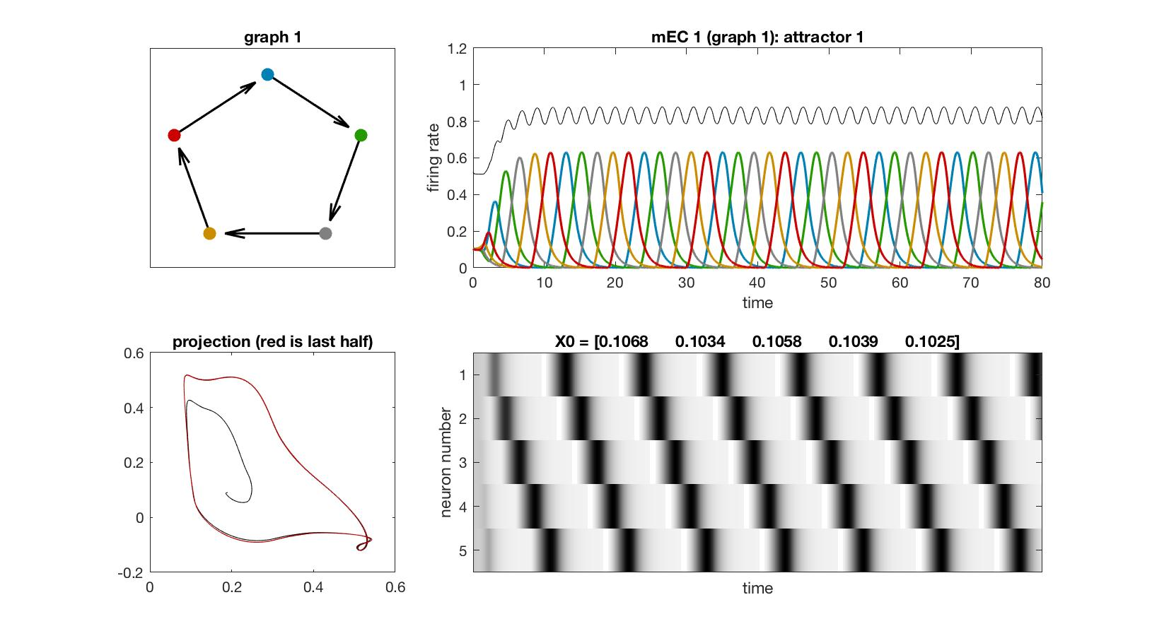
mEC 1

Slide 3
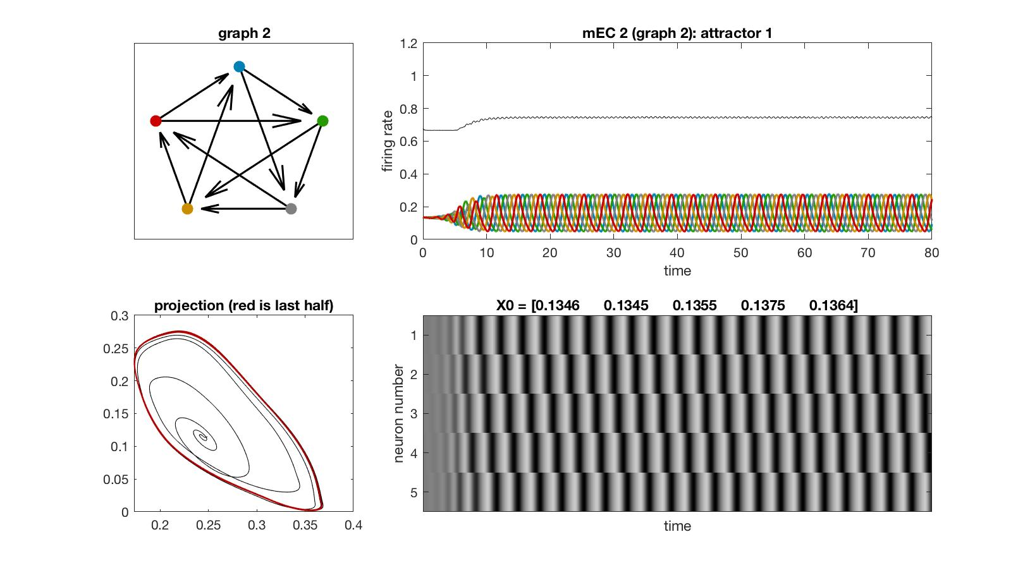
mEC 2

Slide 4
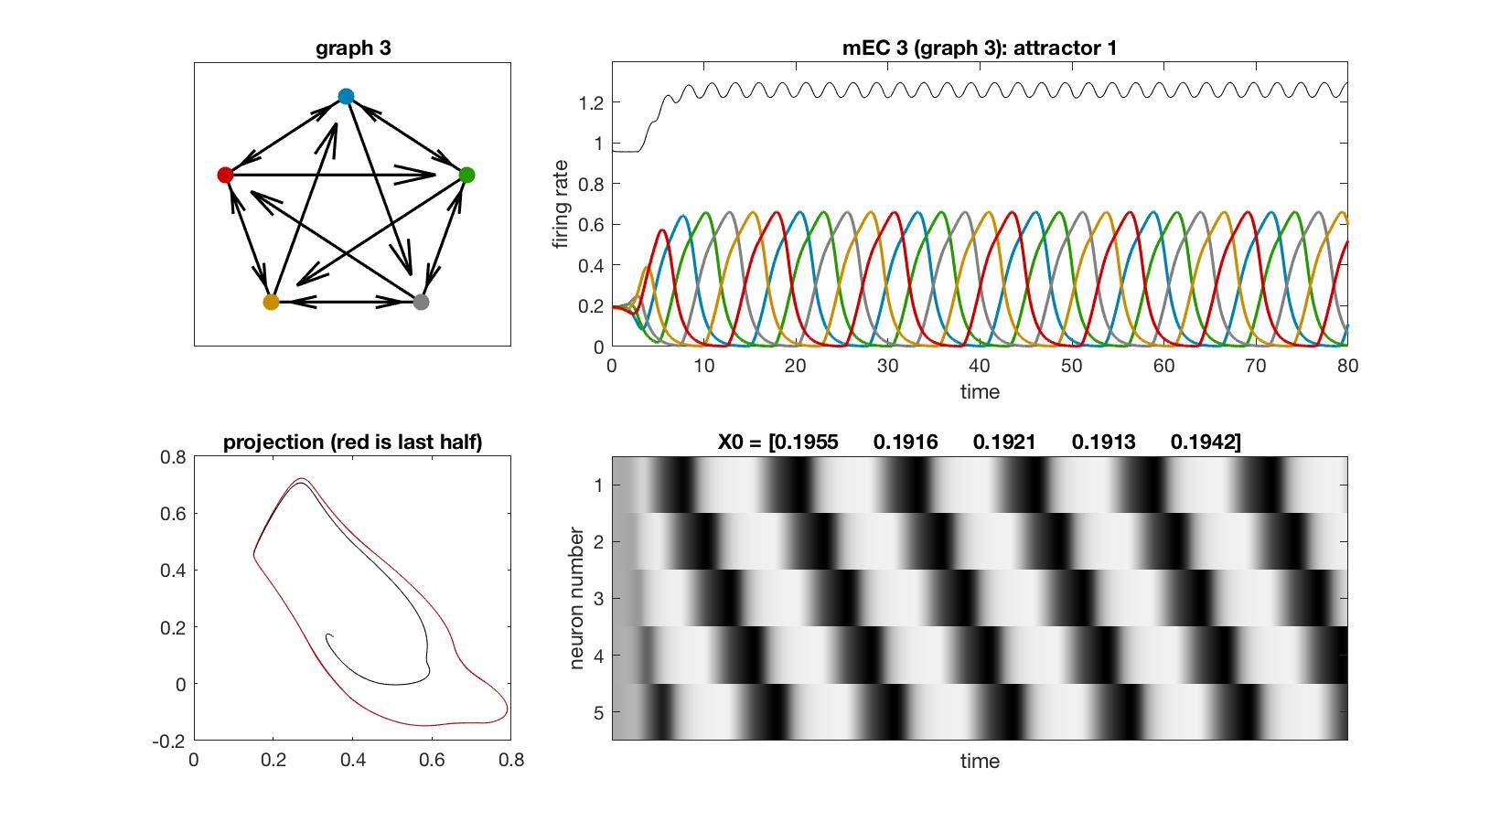
mEC 3

Slide 5
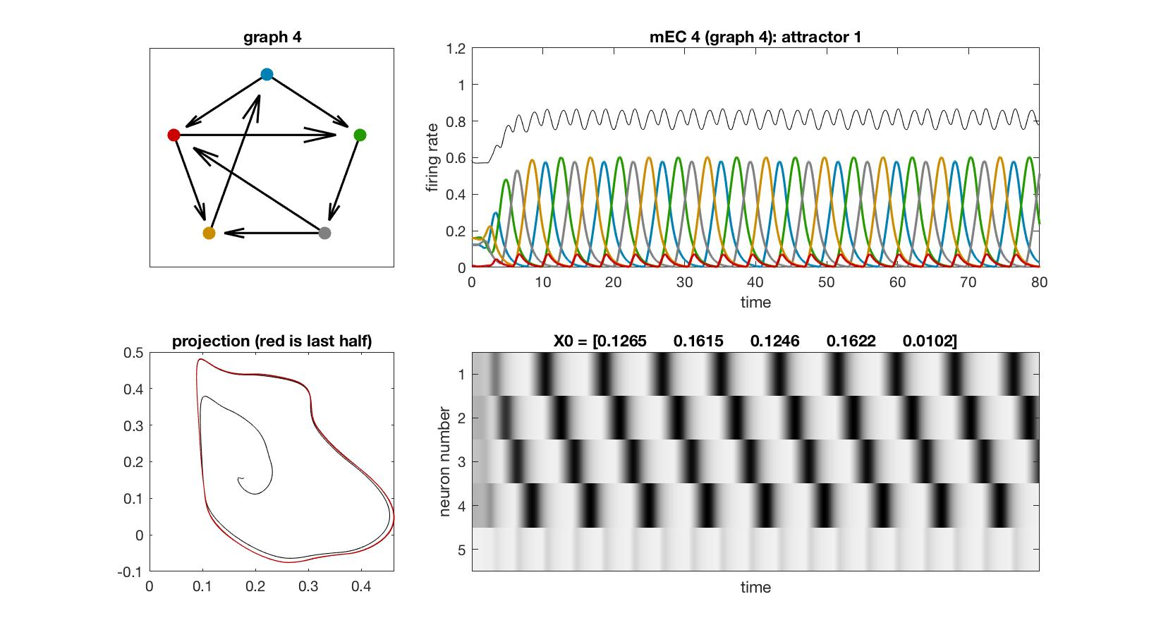
mEC 4

Slide 6
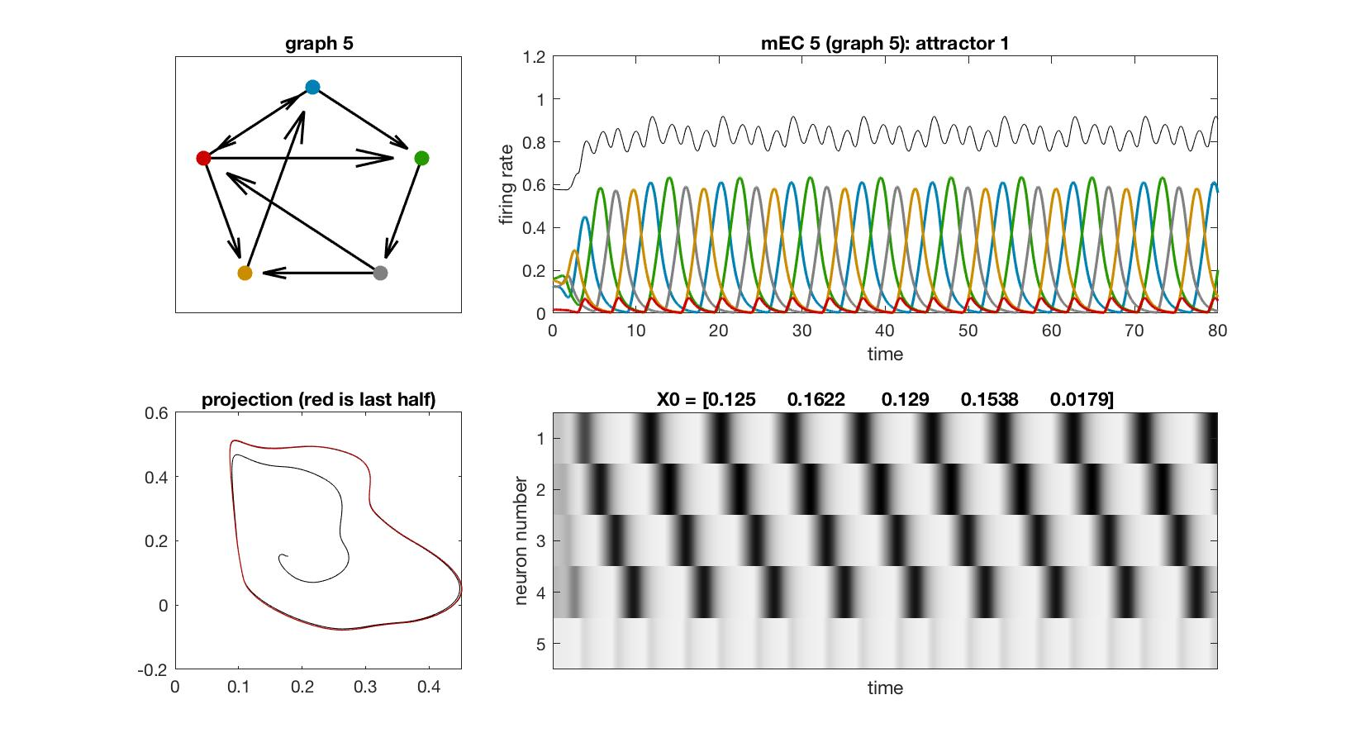
mEC 5

Slide 7

mEC 6

Slide 8
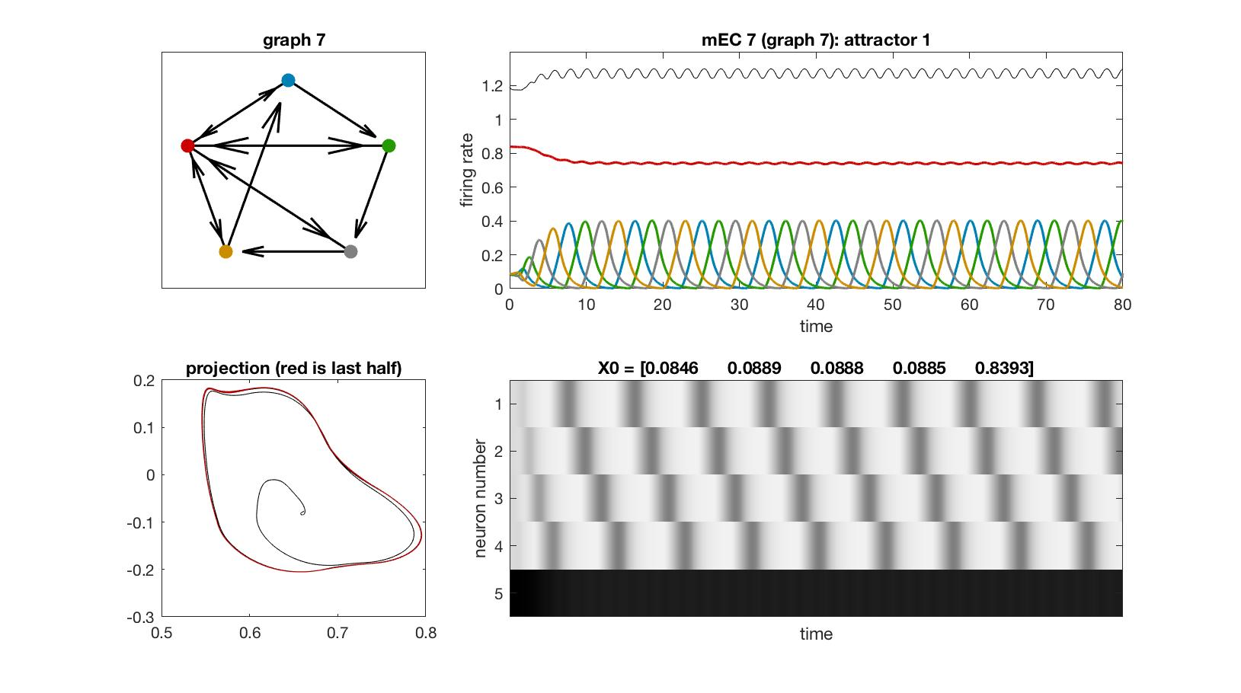
mEC 7

Slide 9
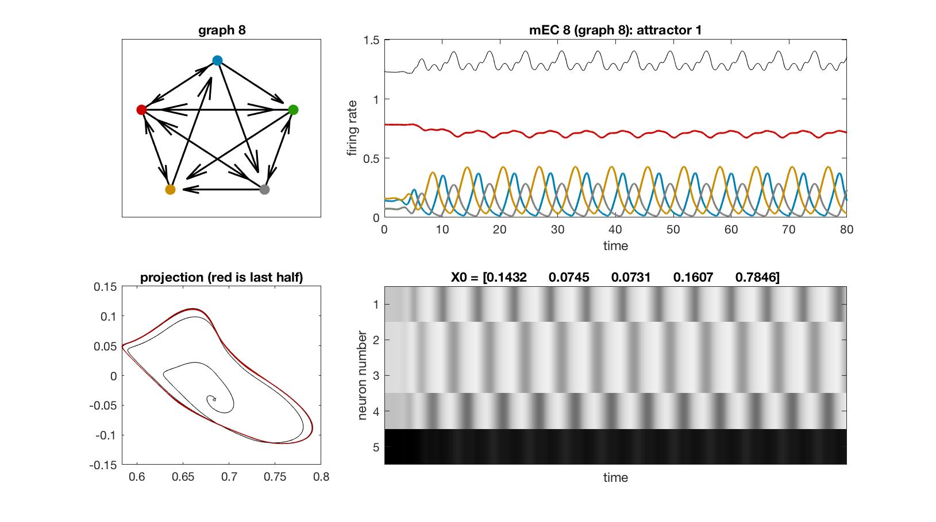
mEC 8

Slide 10
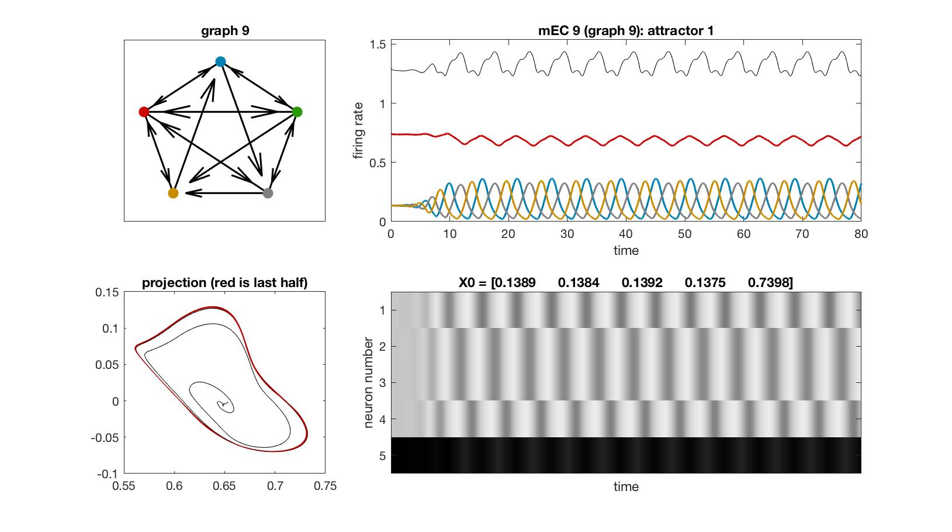
mEC 9

Slide 11
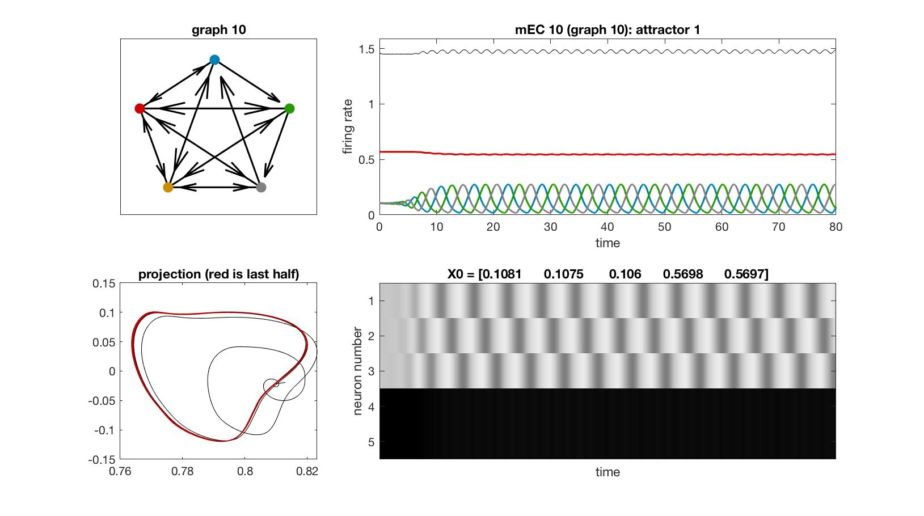
mEC 10

Slide 12
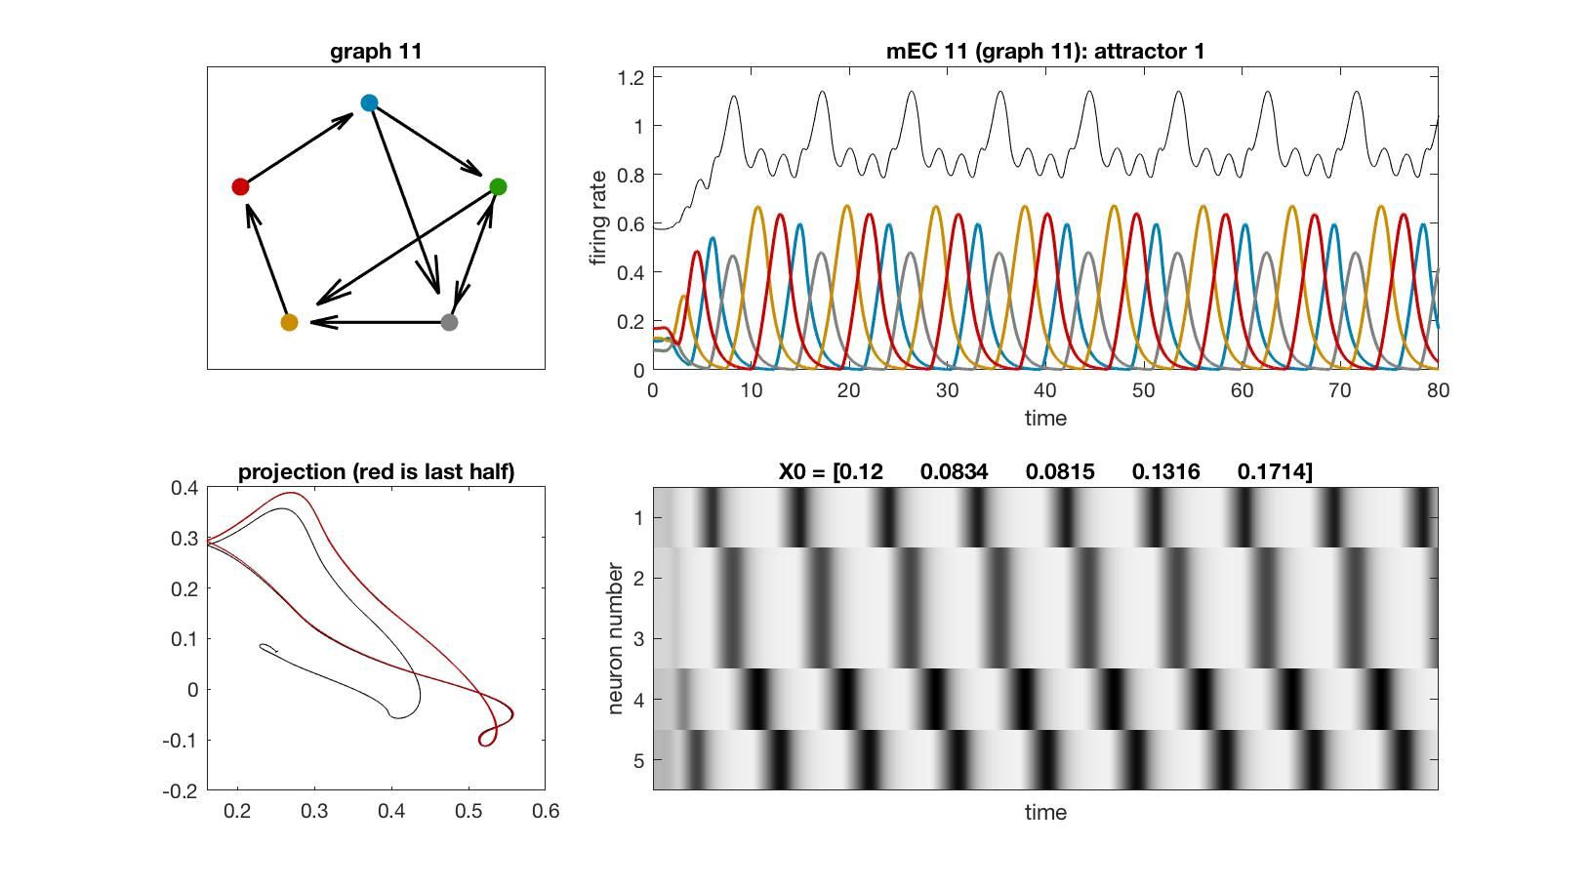
mEC 11

Slide 13

mEC 12

Slide 14
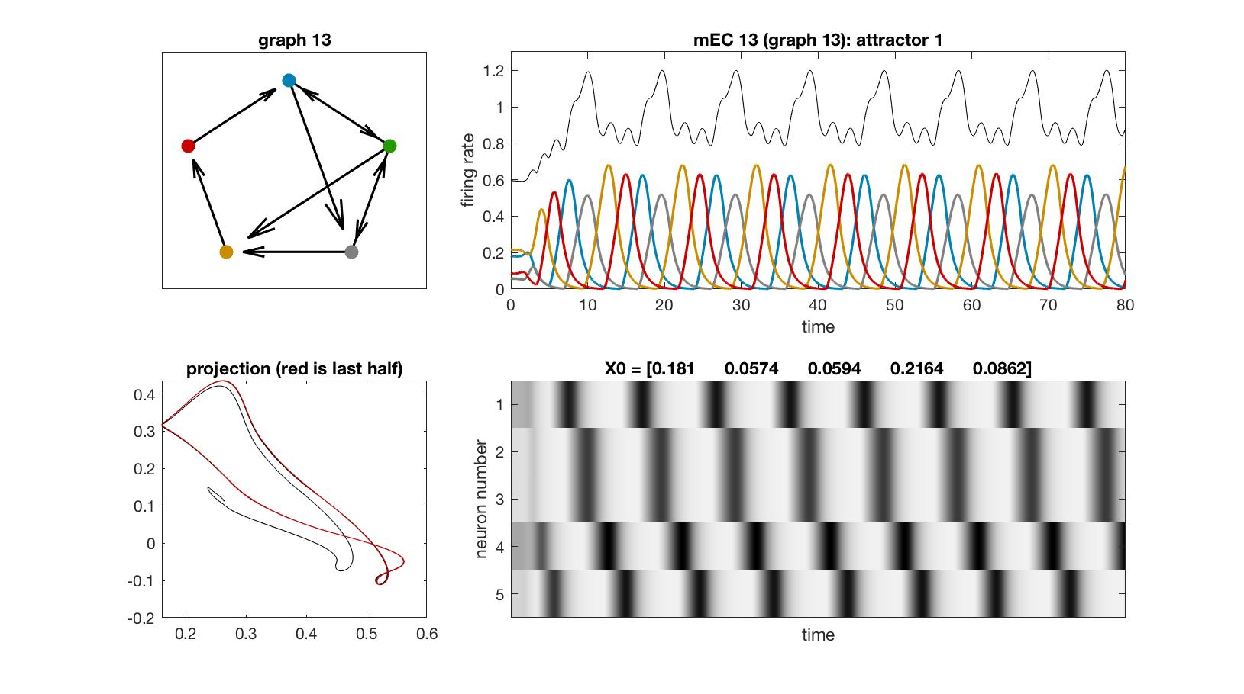
mEC 13

Slide 15

mEC 14

Slide 16

mEC 15

Slide 17
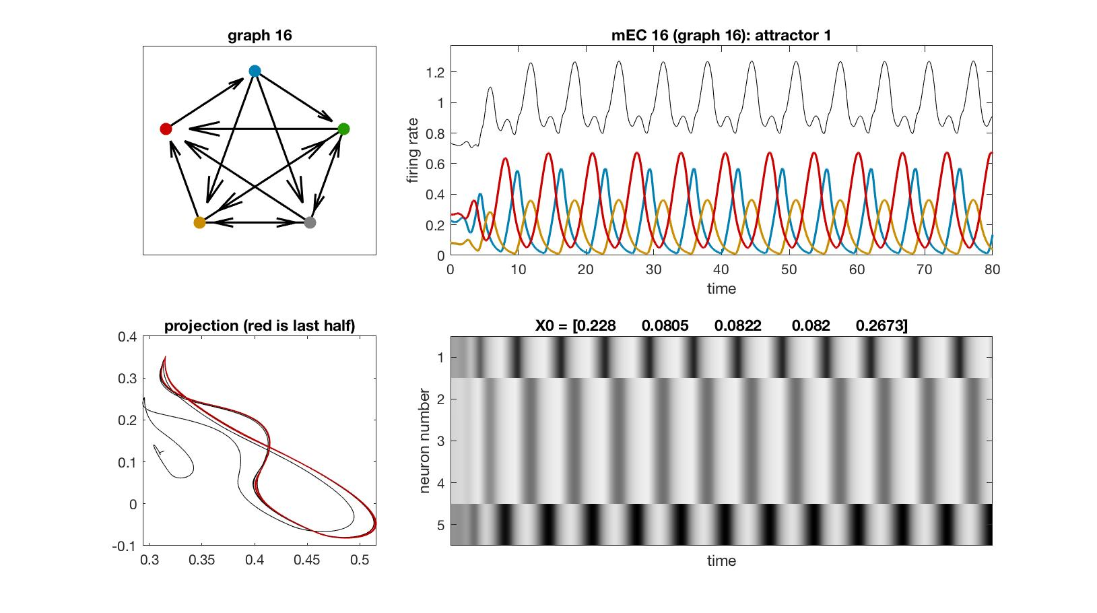
mEC 16

Slide 18
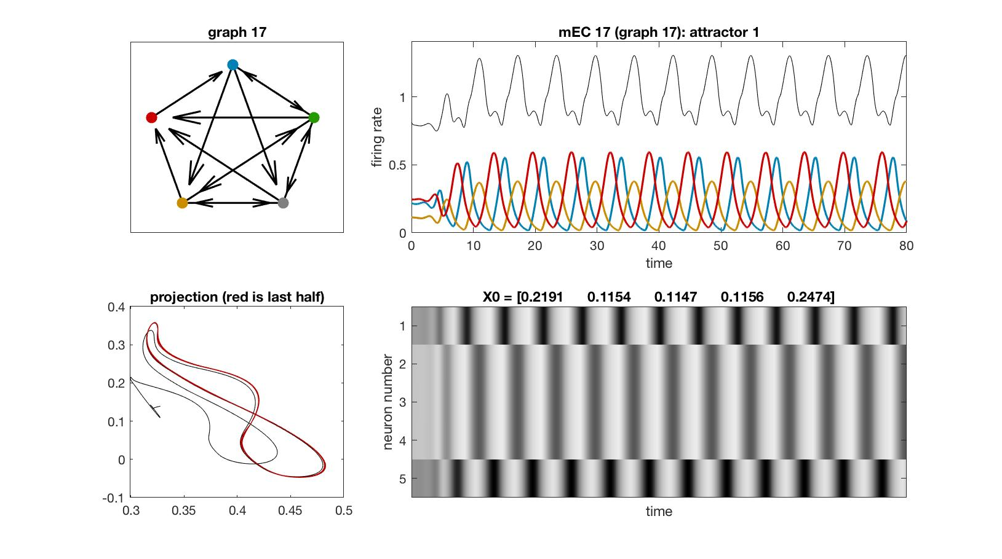
mEC 17

Slide 19

mEC 18

Slide 20
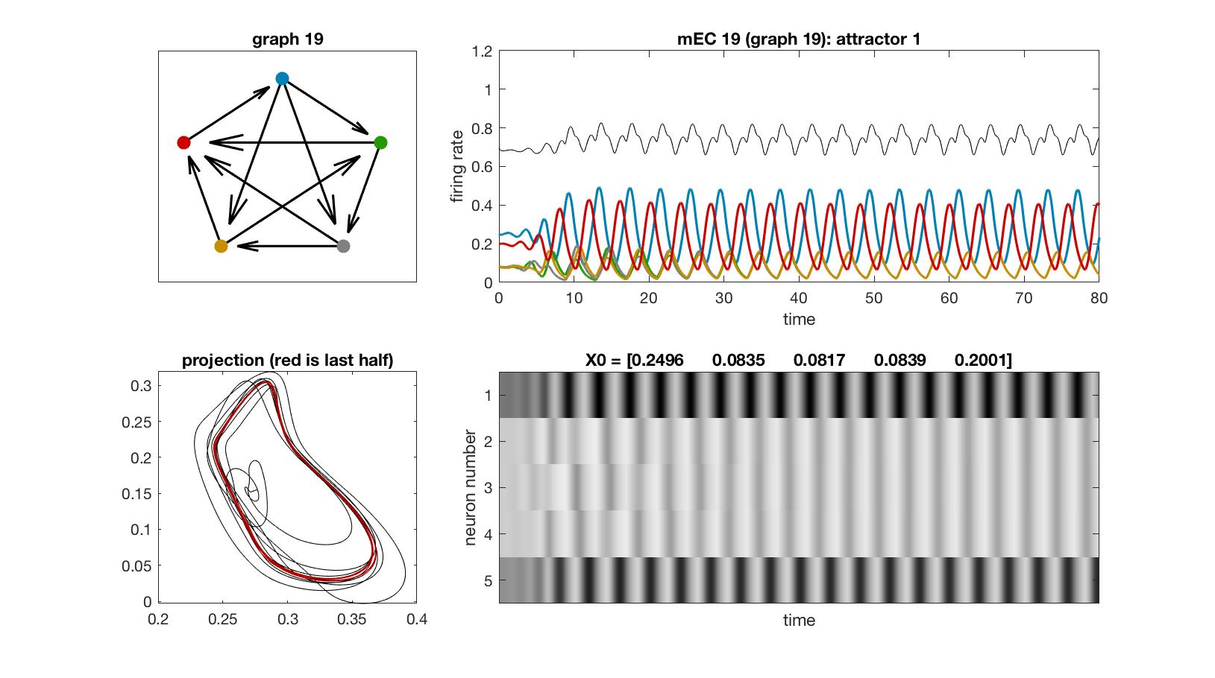
mEC 19

Slide 21
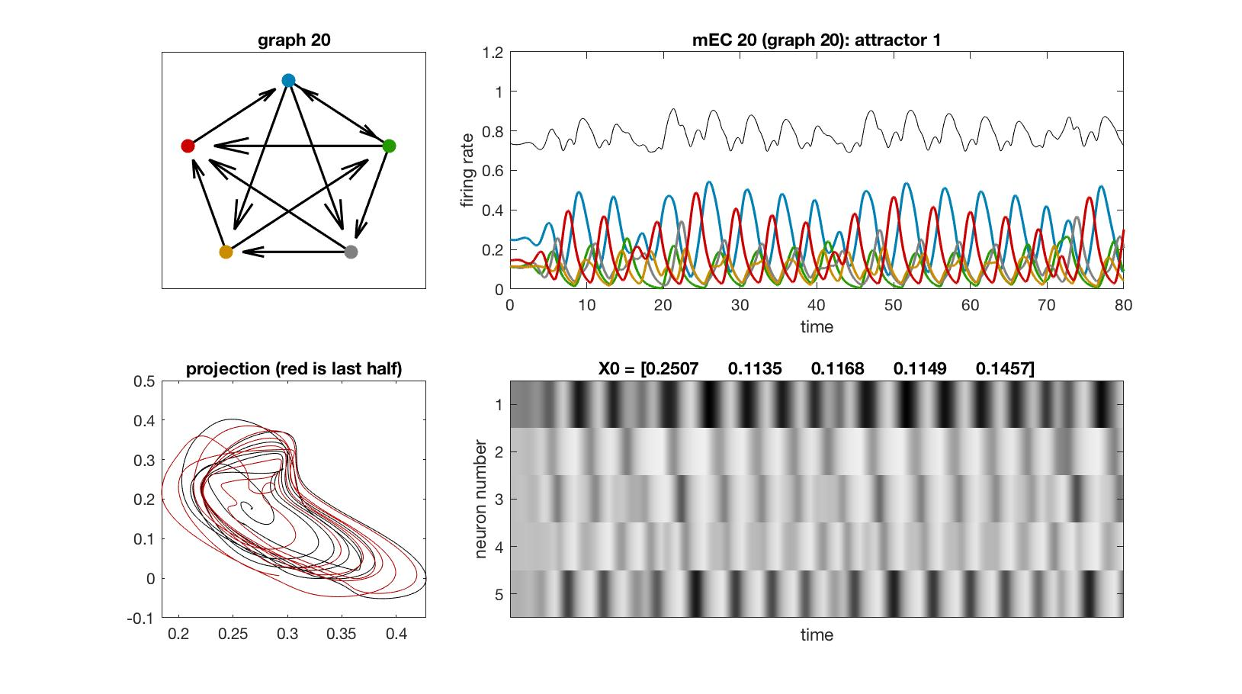
mEC 20

Slide 22
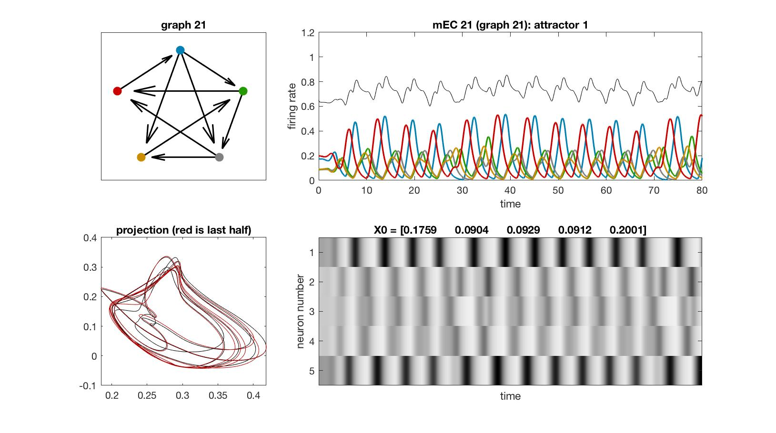
mEC 21

Slide 23
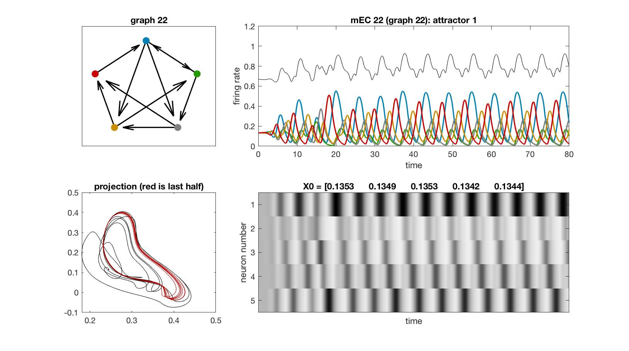
mEC 22

Slide 24
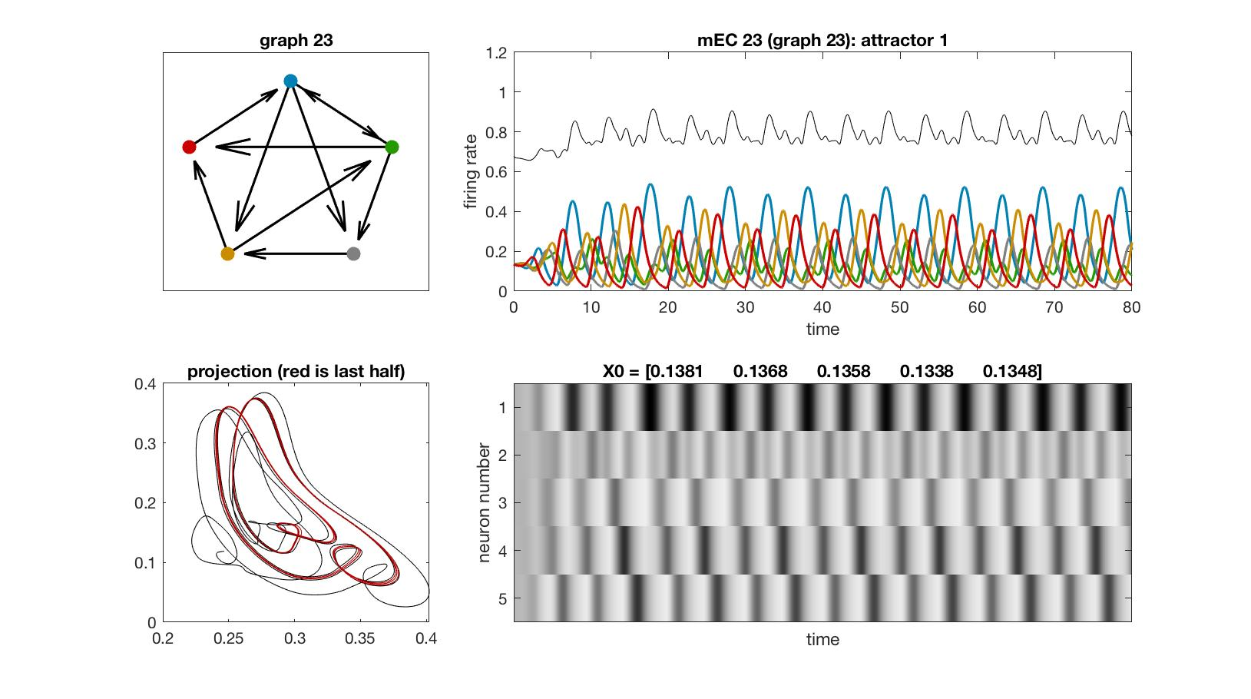
mEC 23

Slide 25
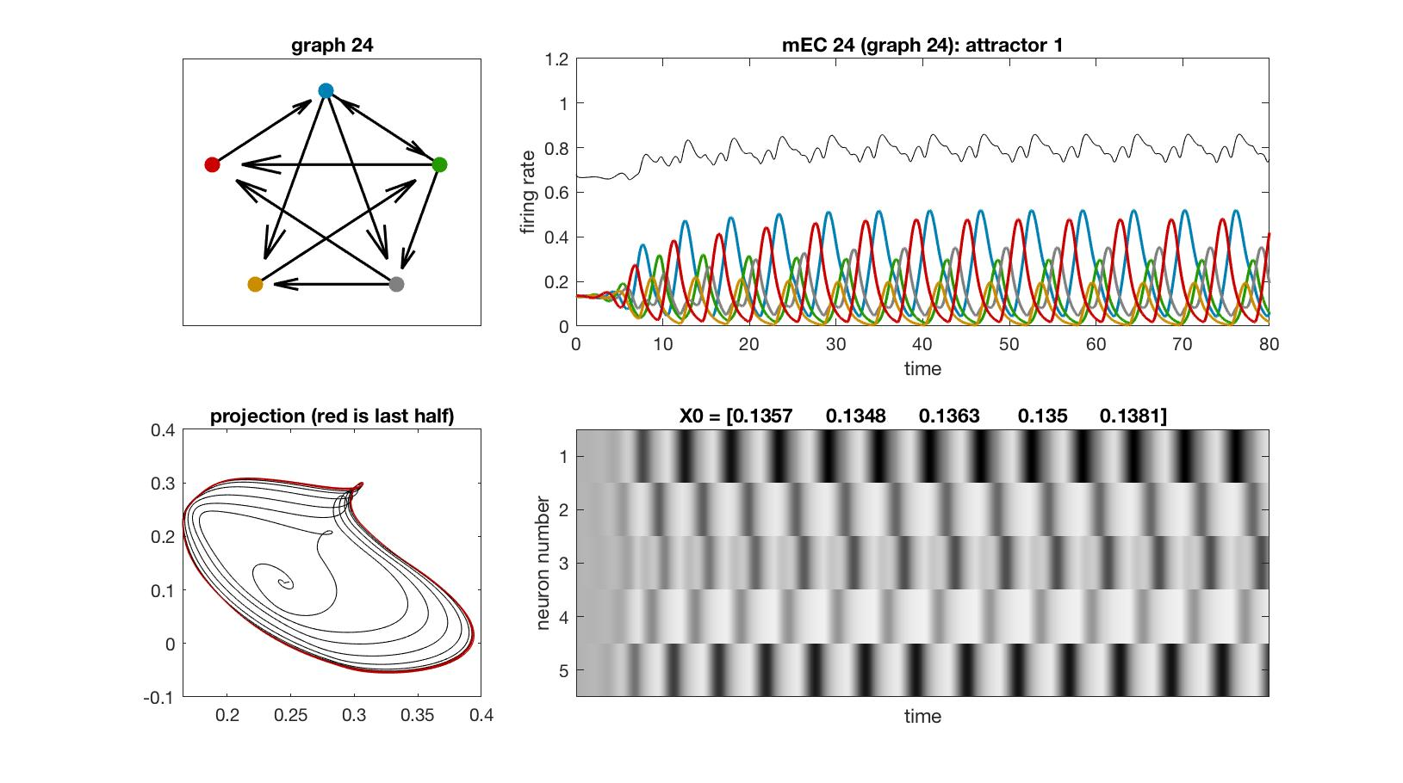
mEC 24

Slide 26
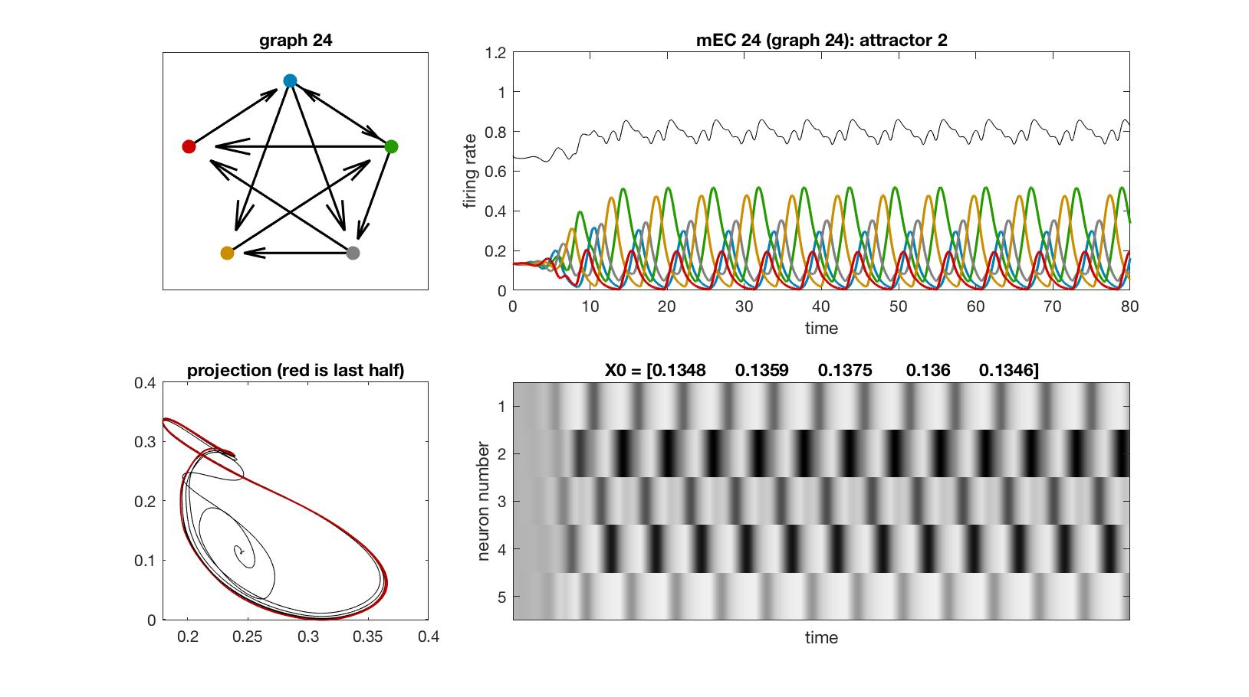
mEC 24

Slide 27
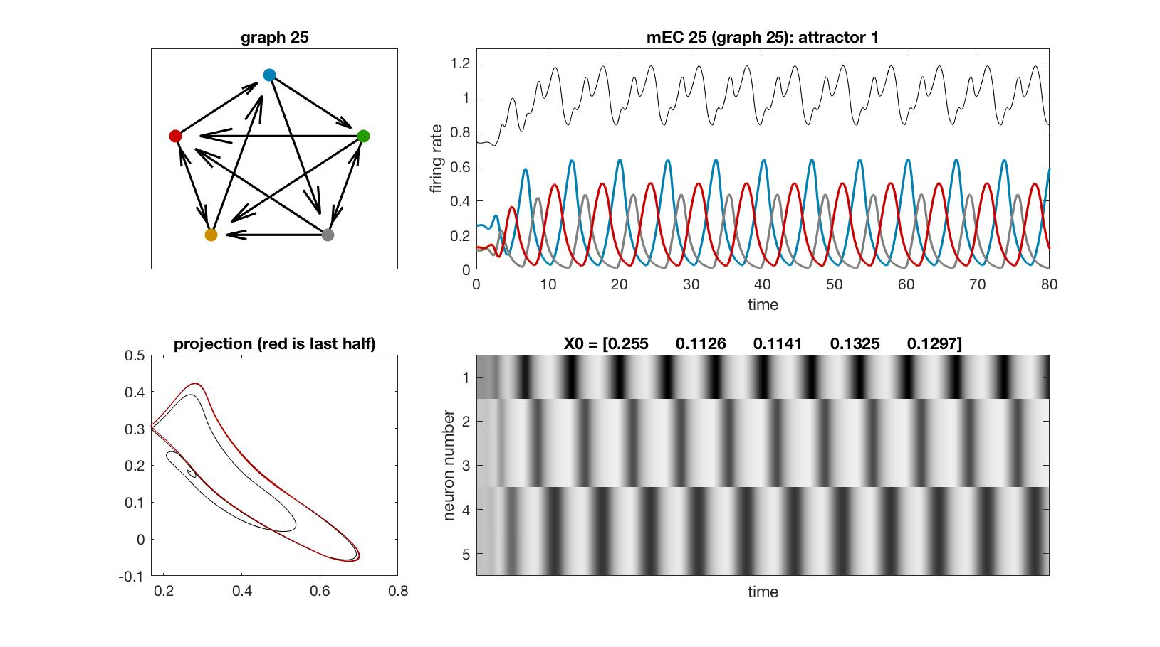
mEC 25

Slide 28
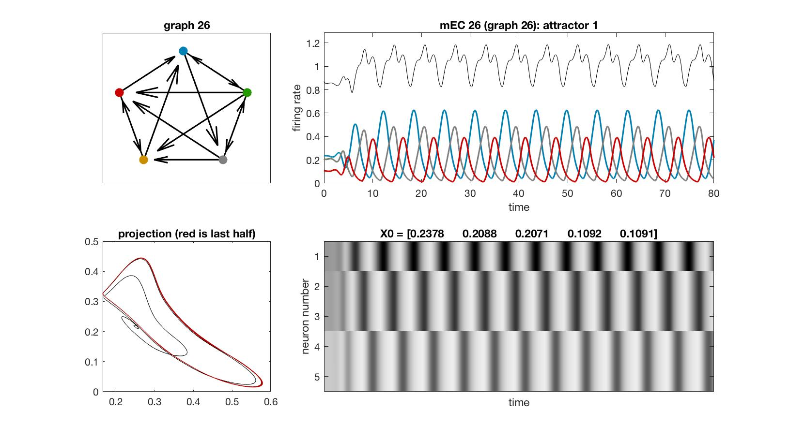
mEC 26

Slide 29
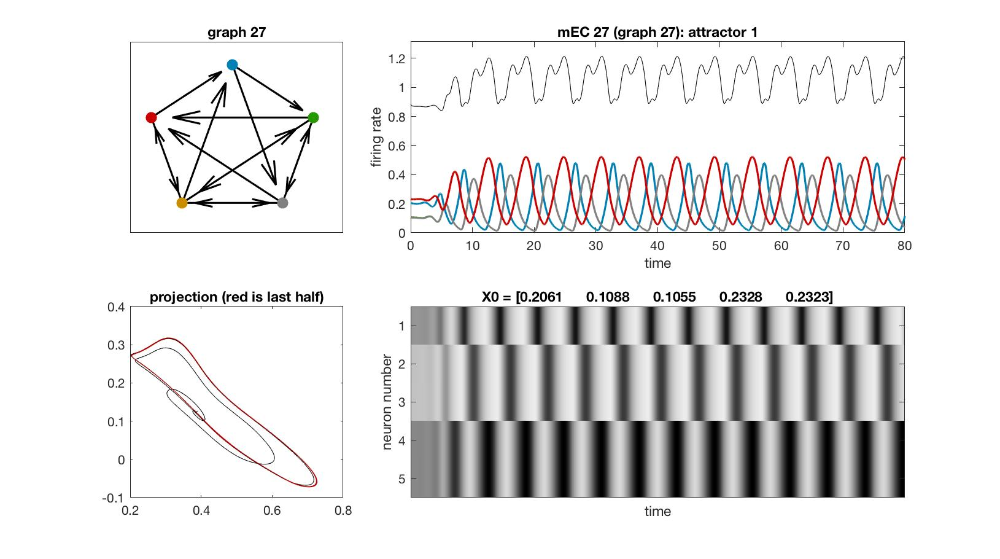
mEC 27

Slide 30
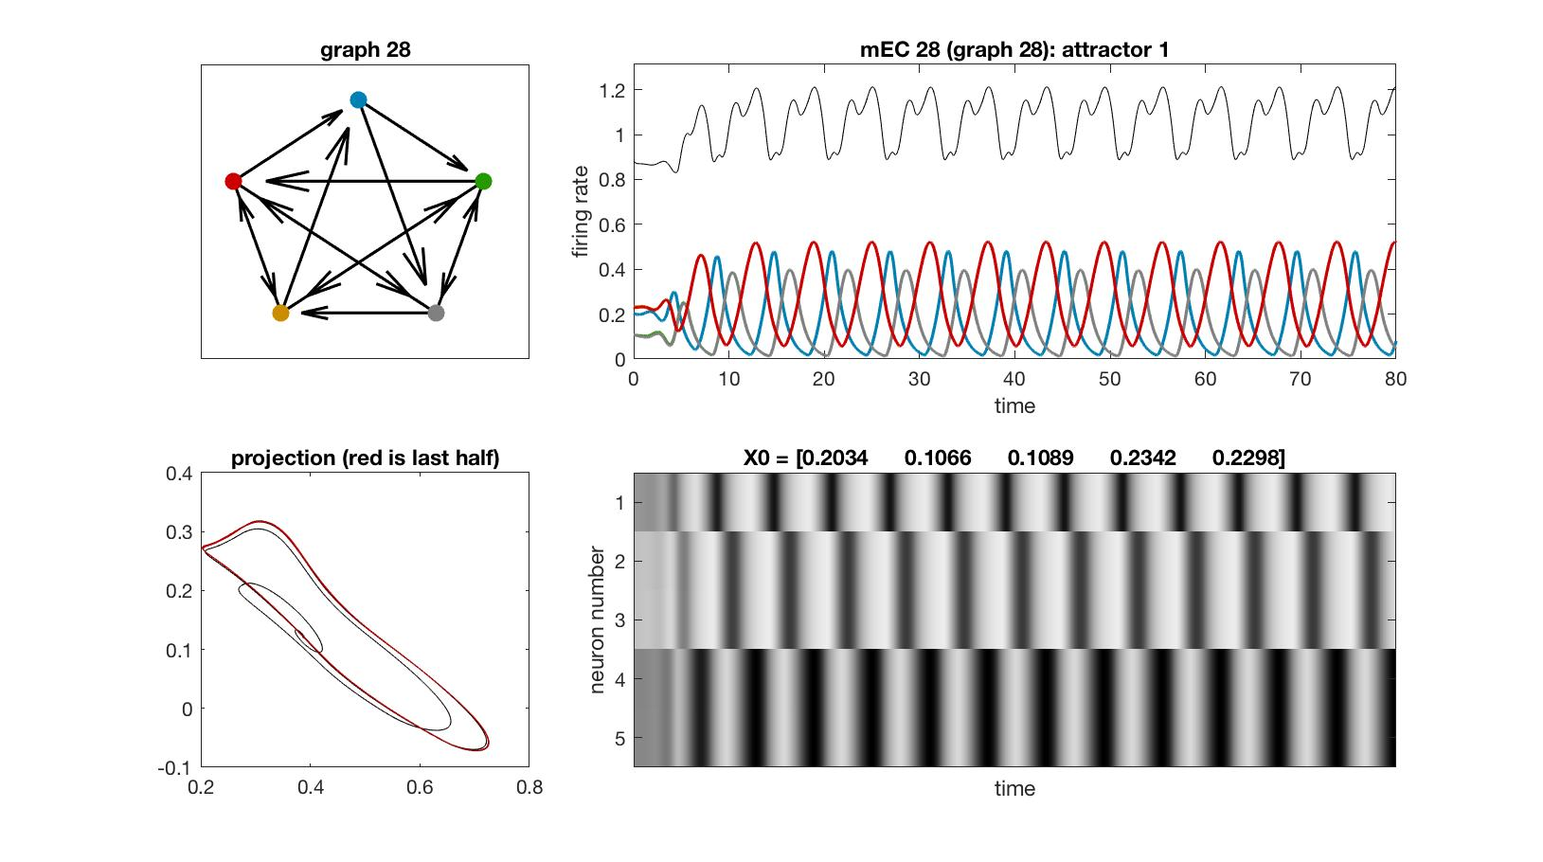
mEC 28

Slide 31
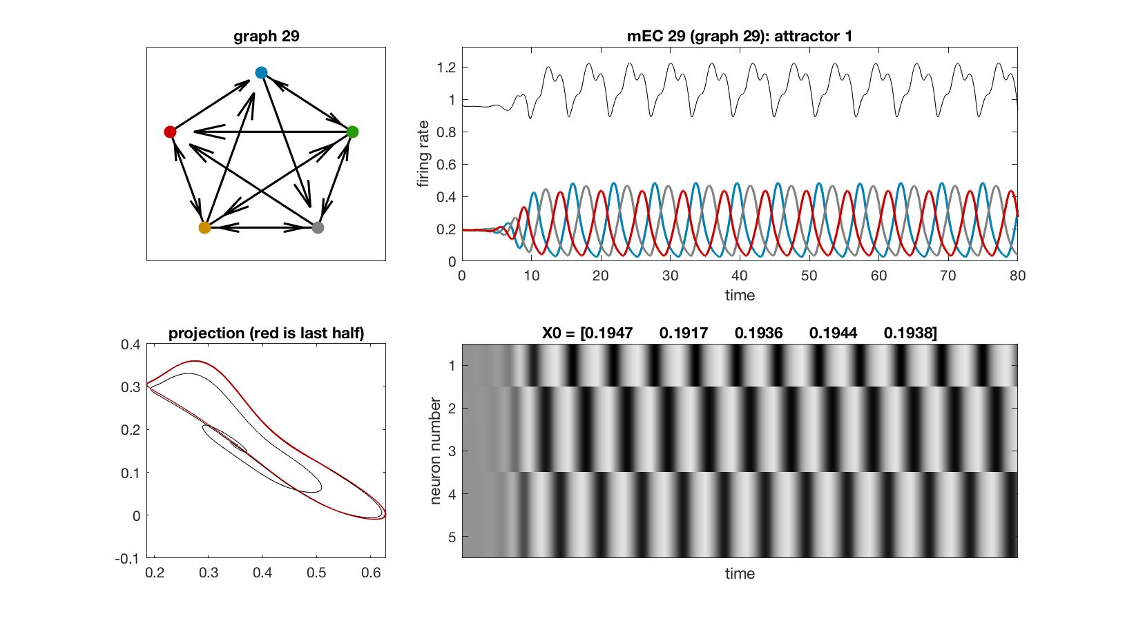
mEC 29

Slide 32

mEC 30

Slide 33
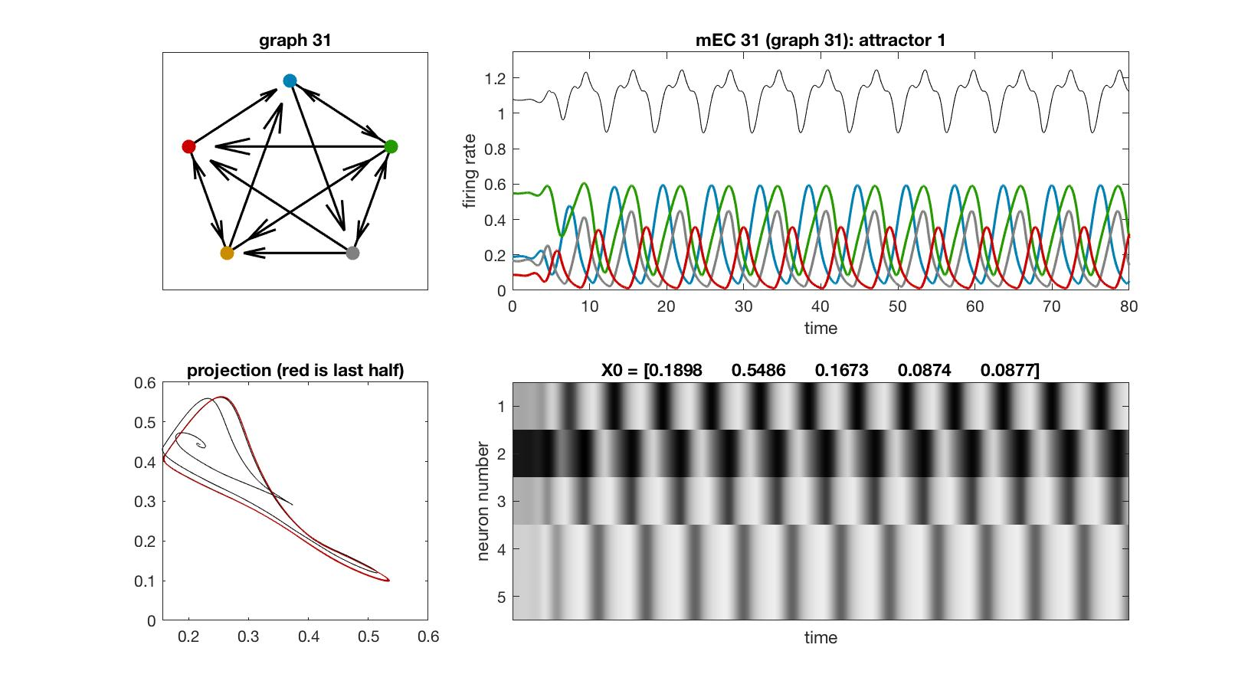
mEC 31

Slide 34
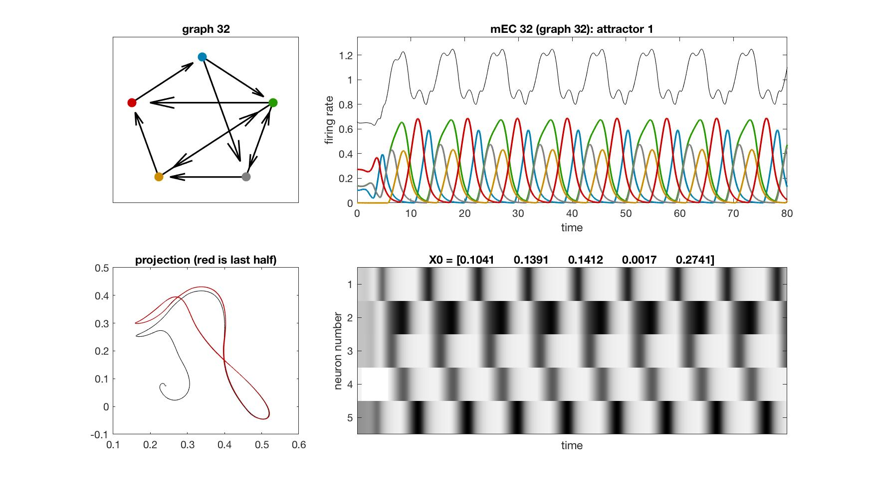
mEC 32

Slide 35
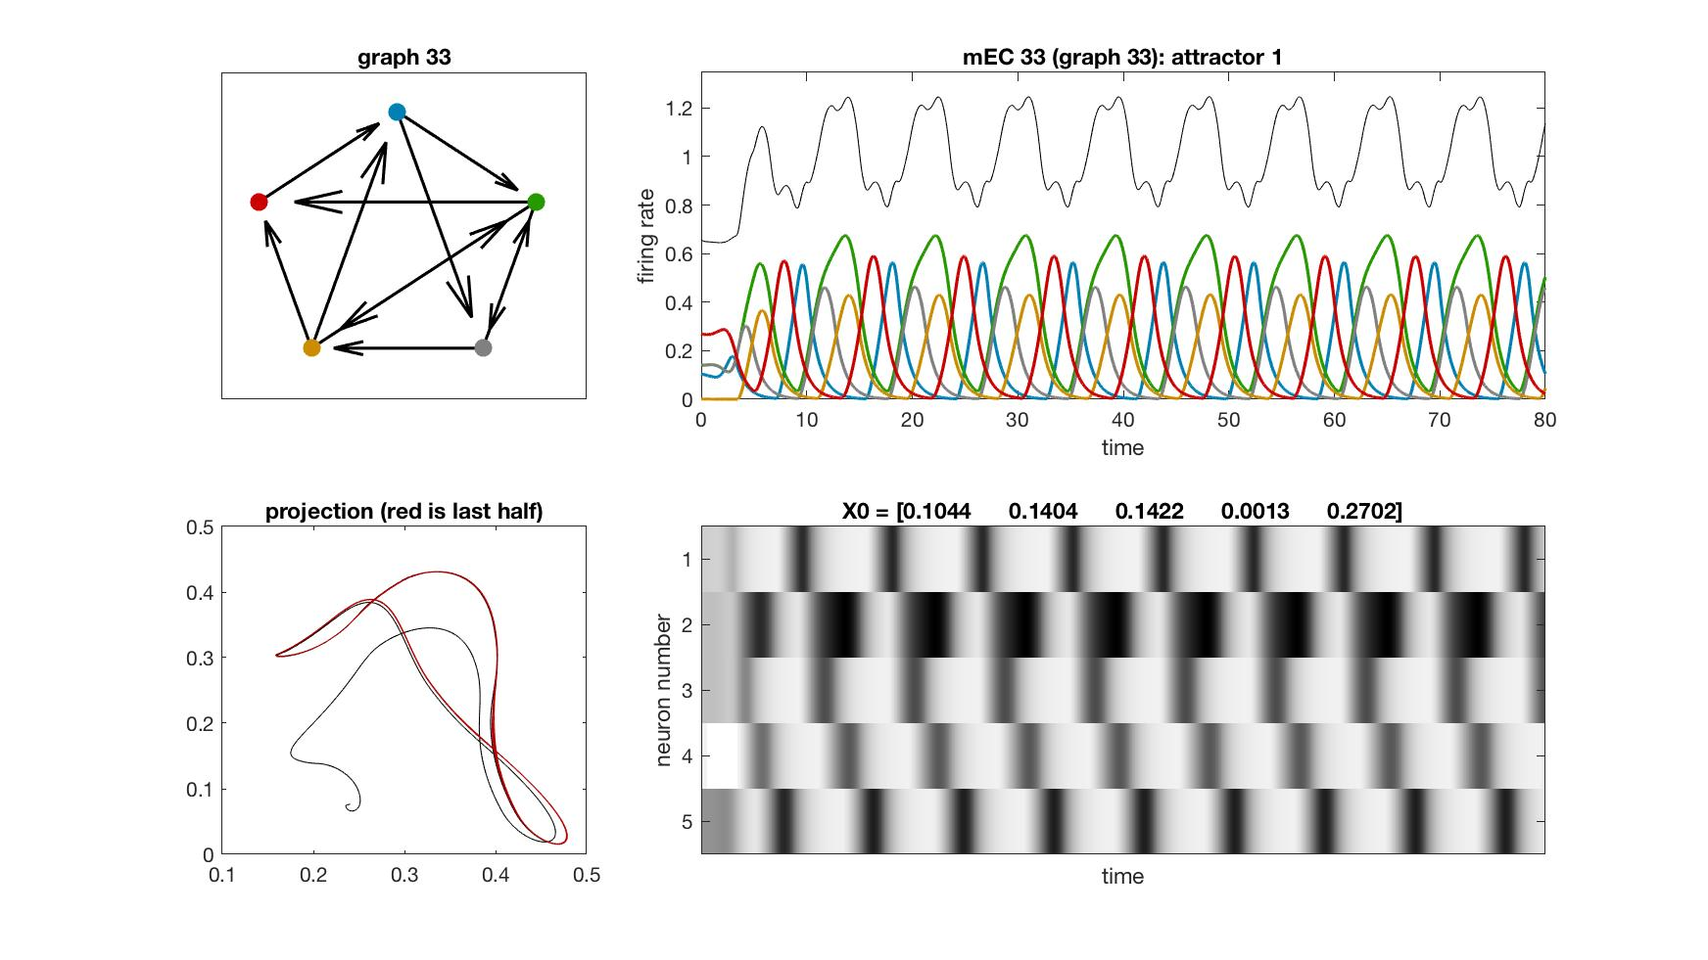
mEC 33

Slide 36
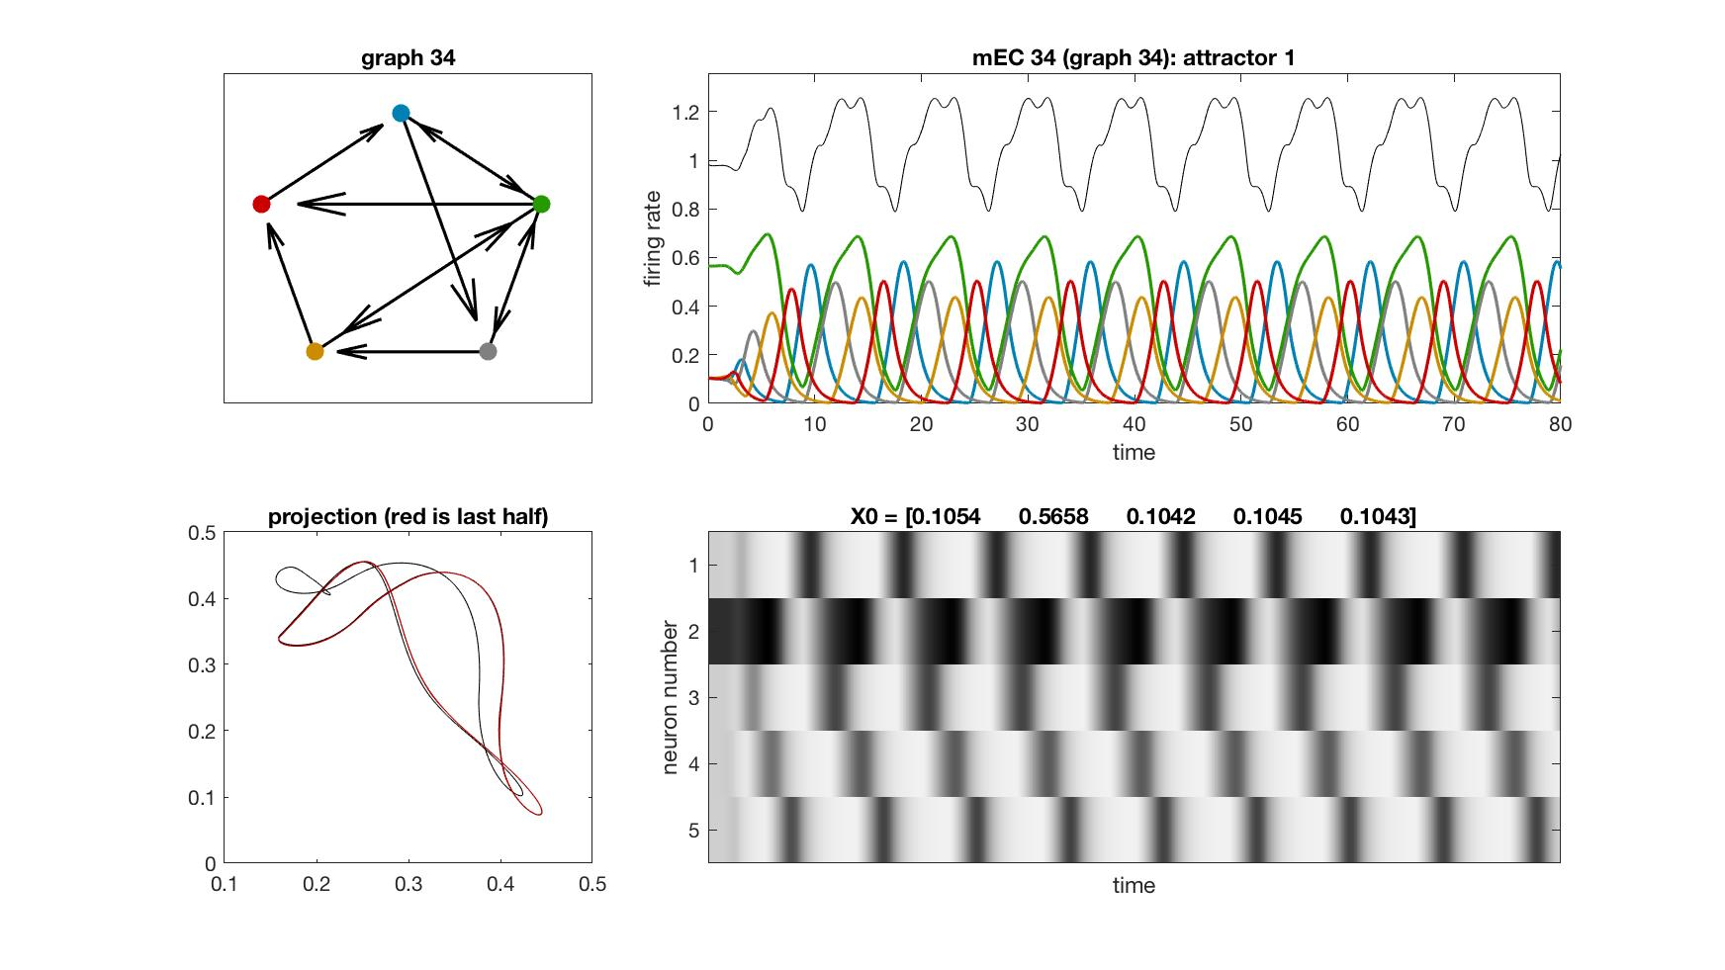
mEC 34

Slide 37
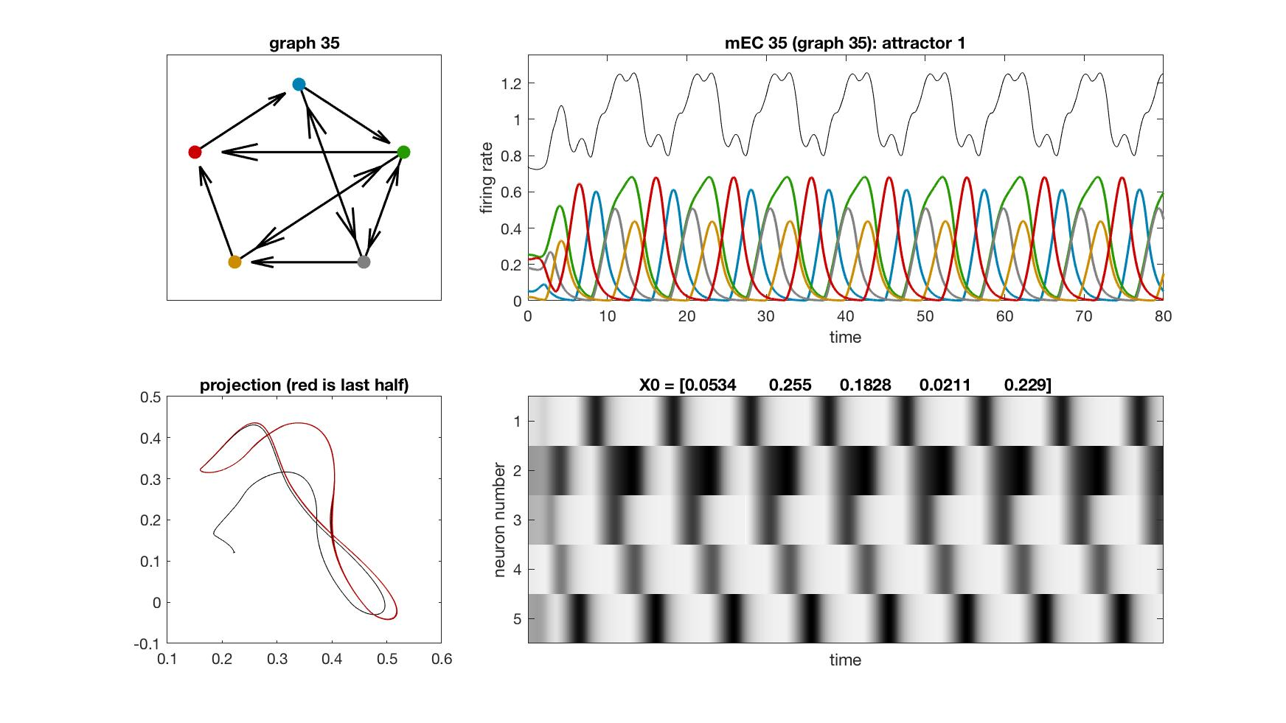
mEC 35

Slide 38
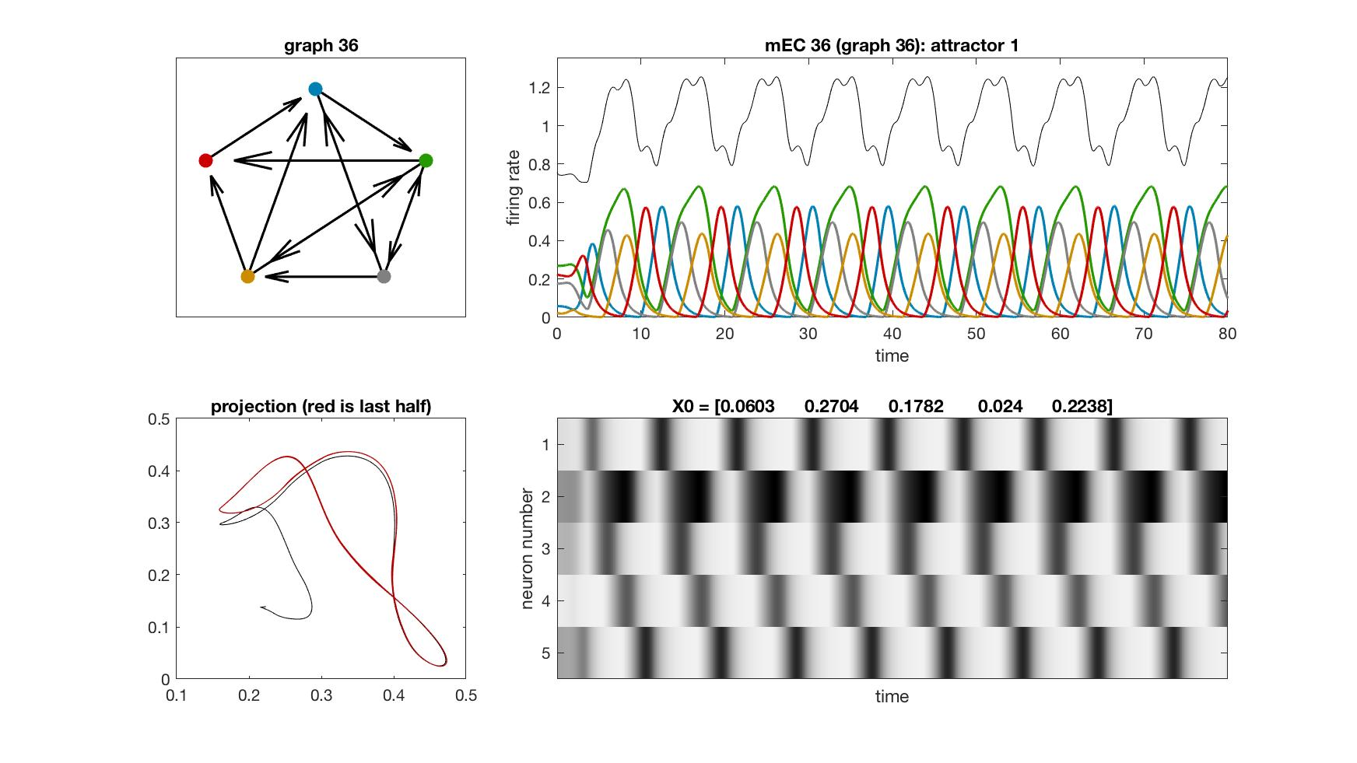
mEC 36

Slide 39
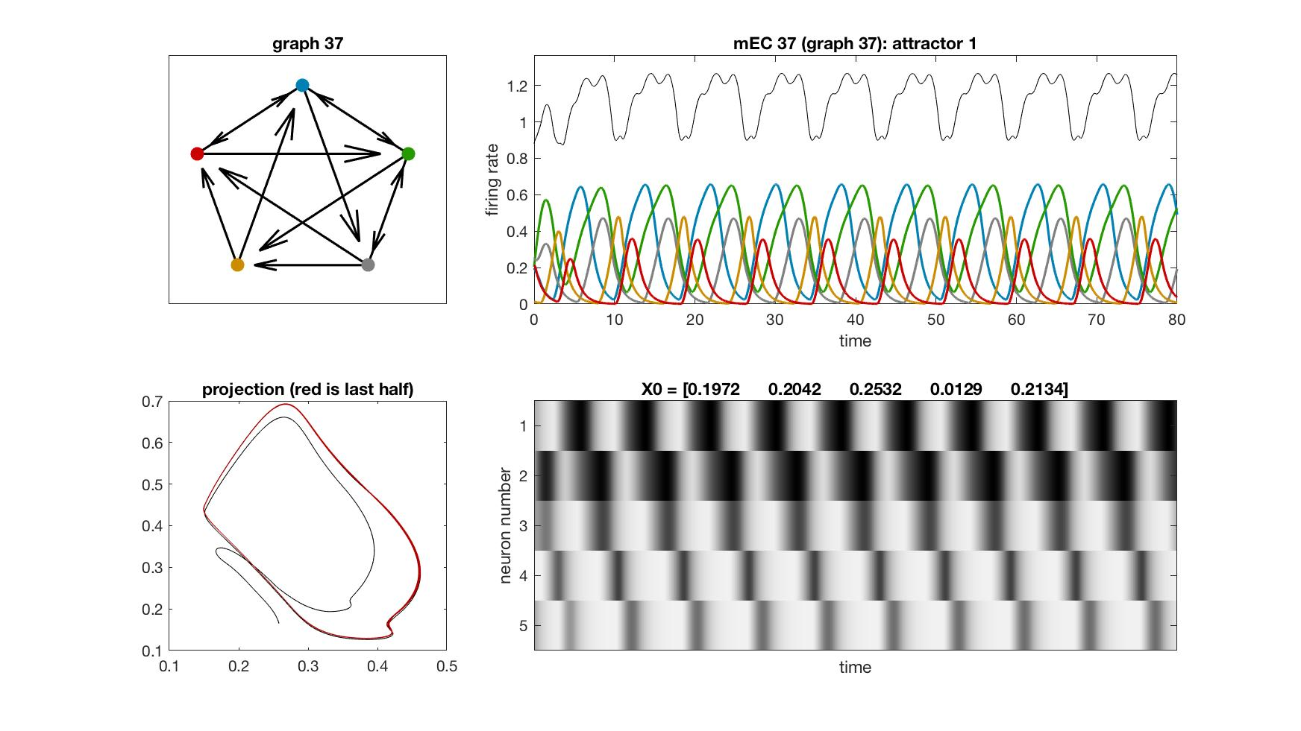
mEC 37

Slide 40
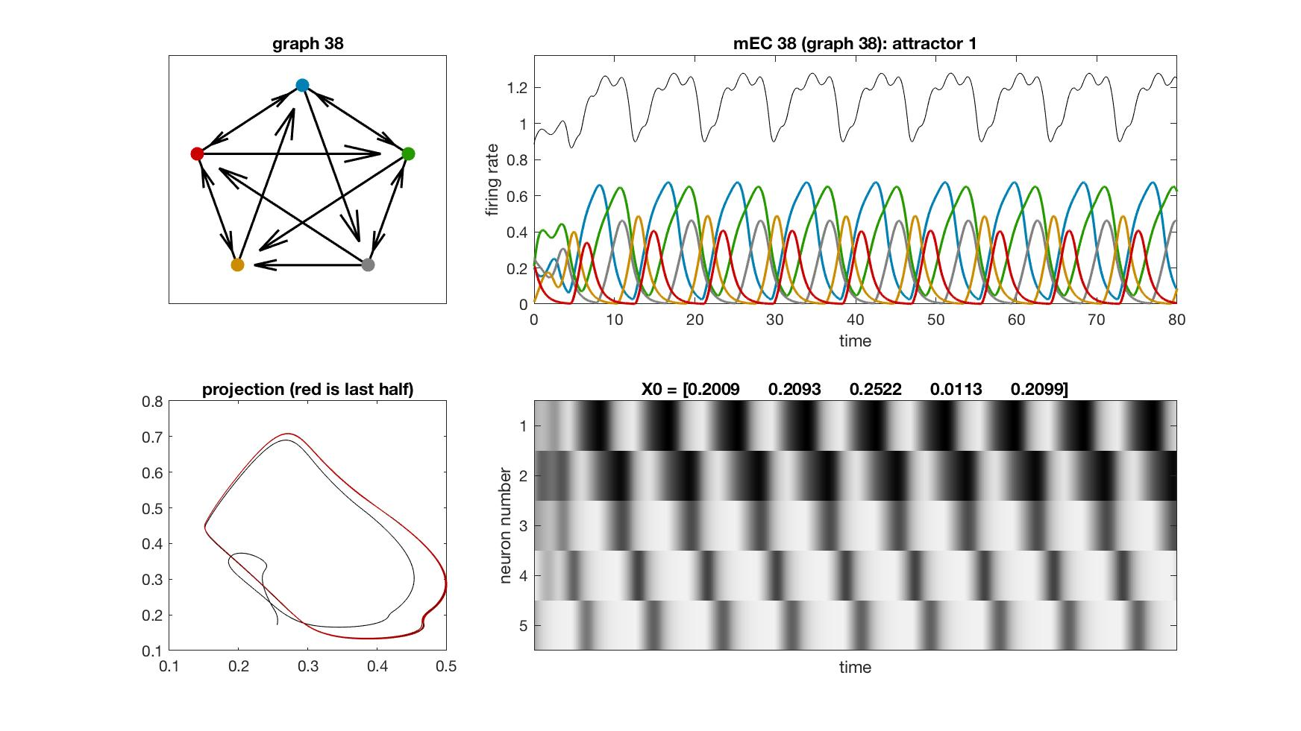
mEC 38

Slide 41
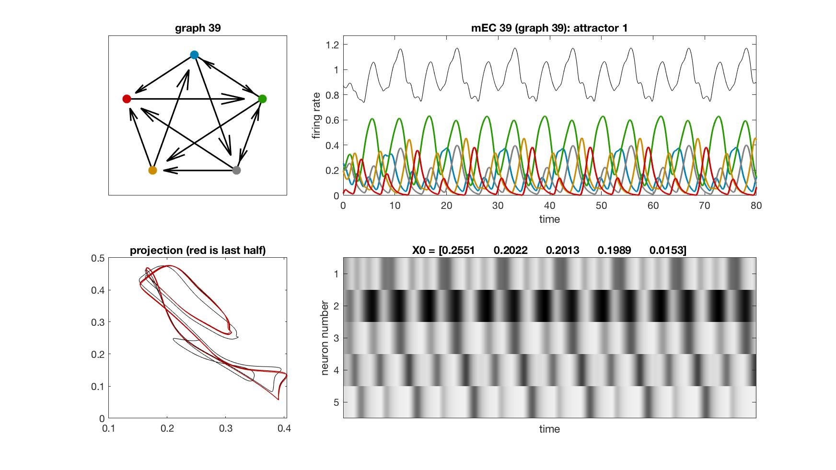
mEC 39

Slide 42
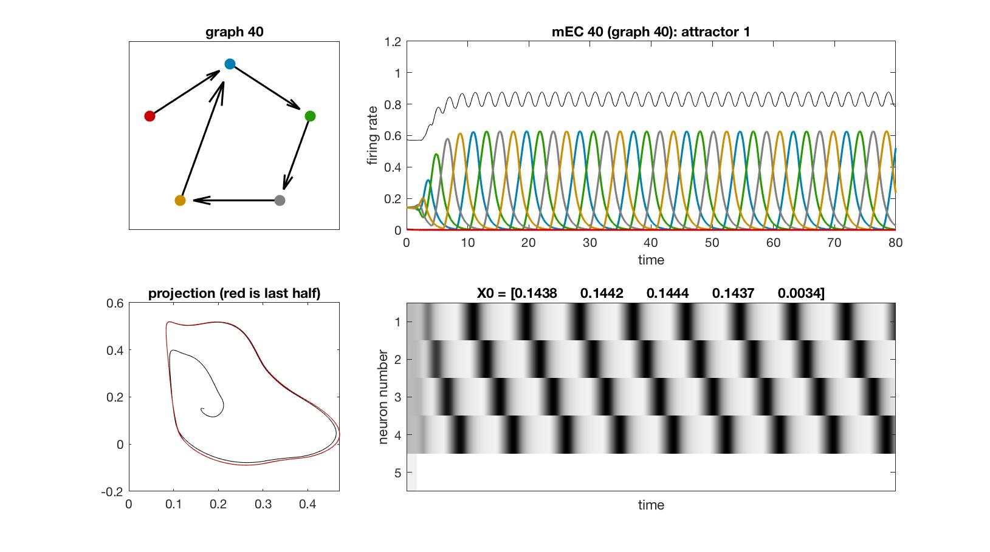
mEC 40

Slide 43
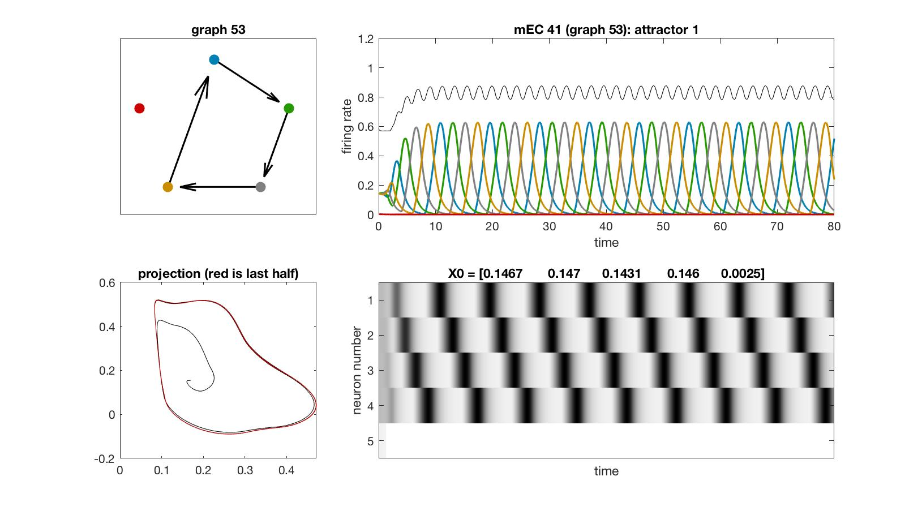
mEC 41

Slide 44
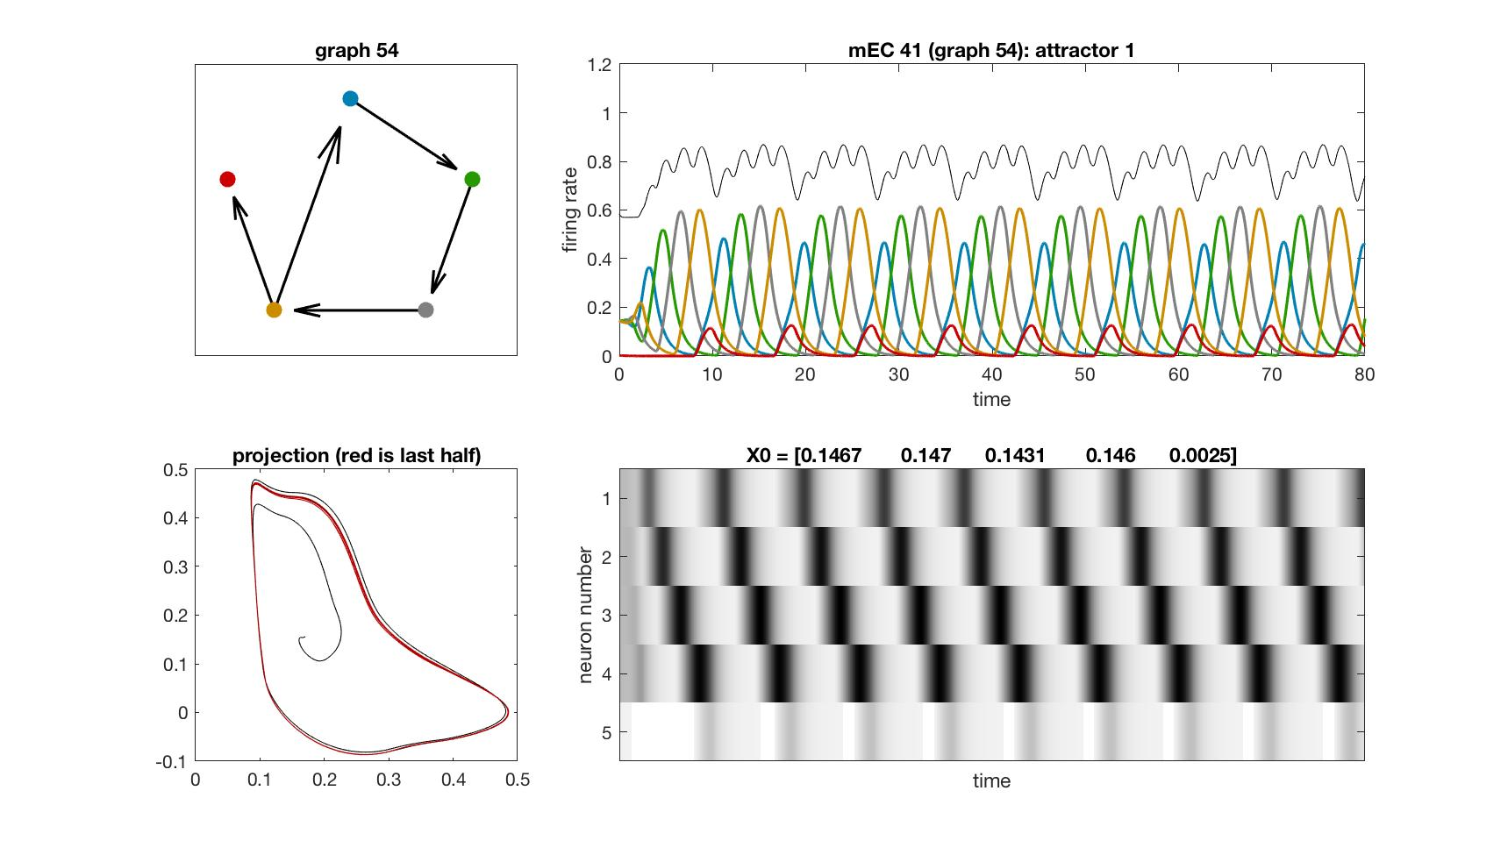
mEC 41

Slide 45
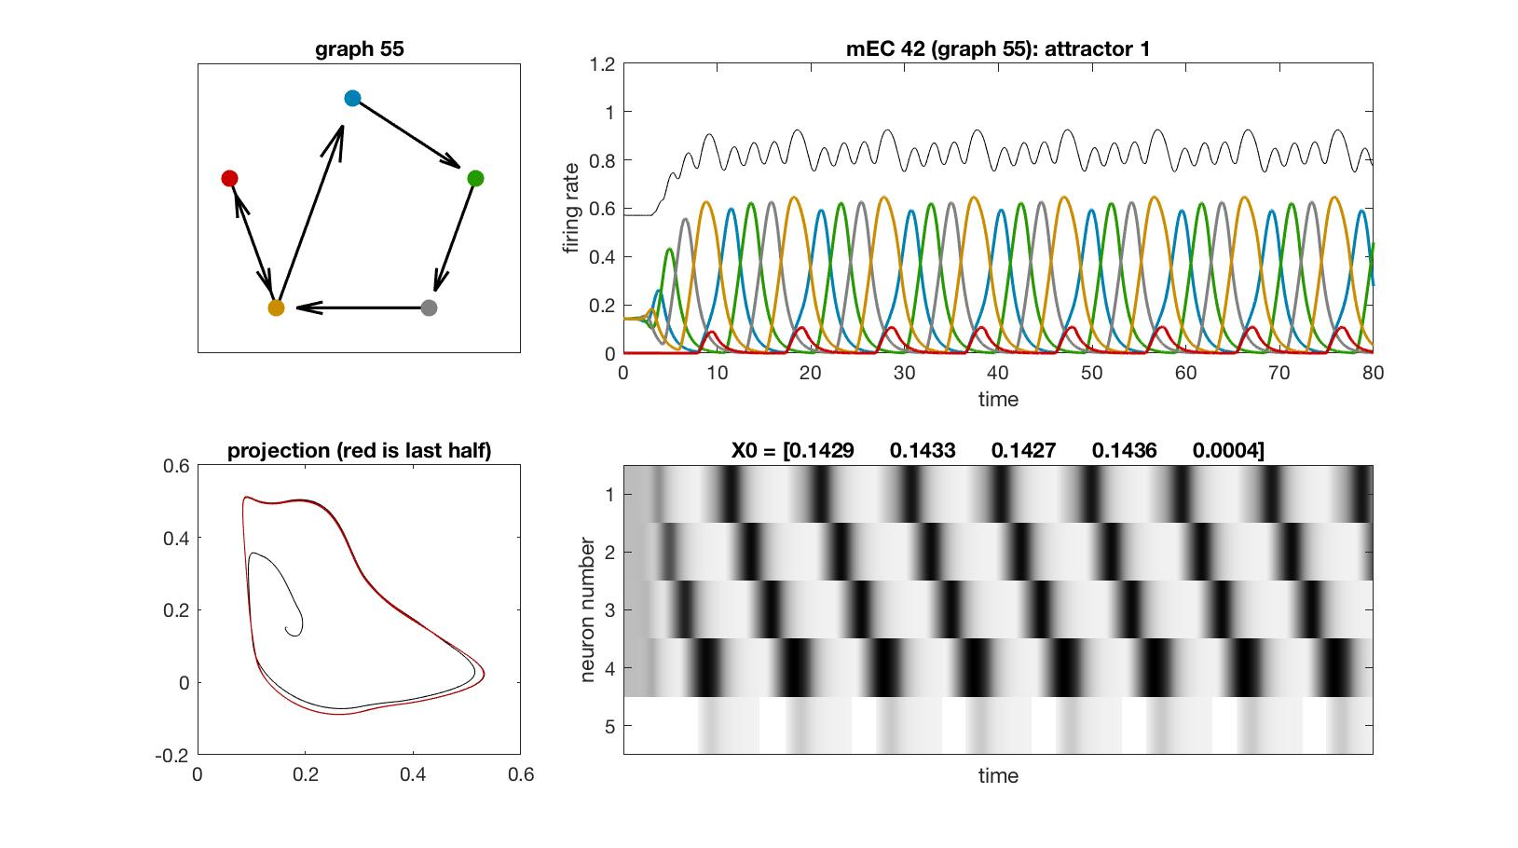
mEC 42

Slide 46
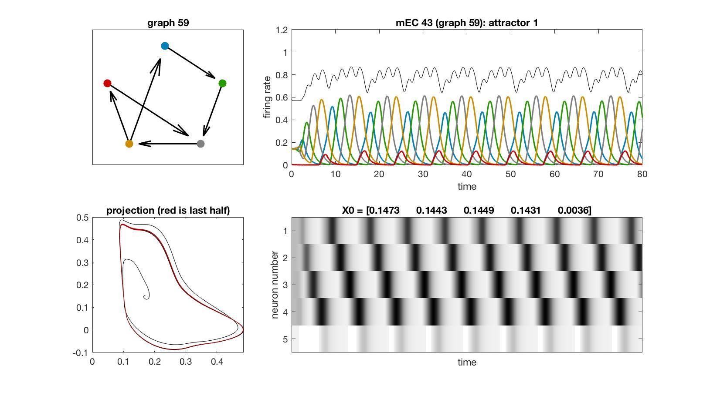
mEC 43

Slide 47
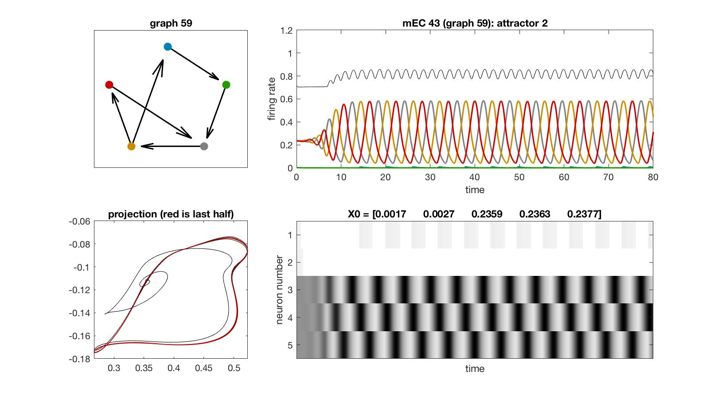
mEC 43

Slide 48
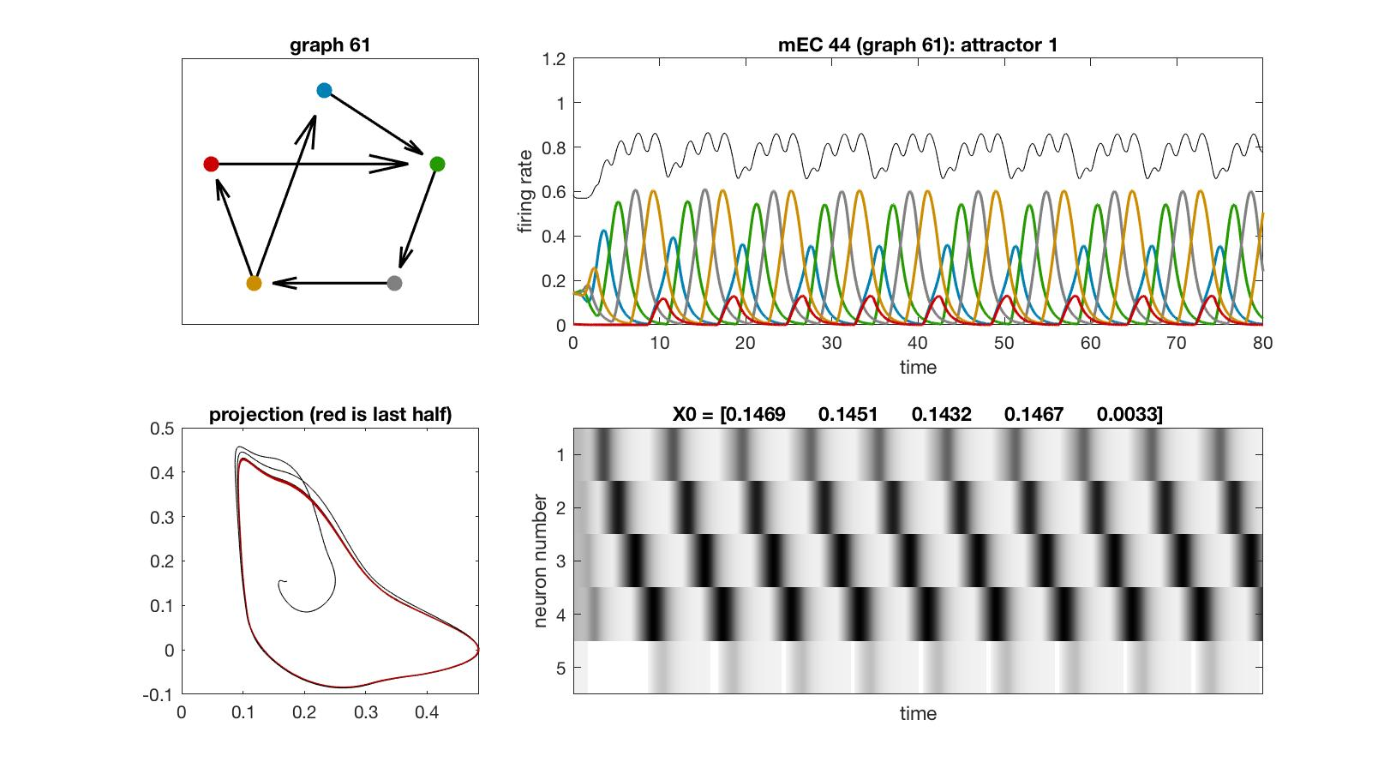
mEC 44

Slide 49
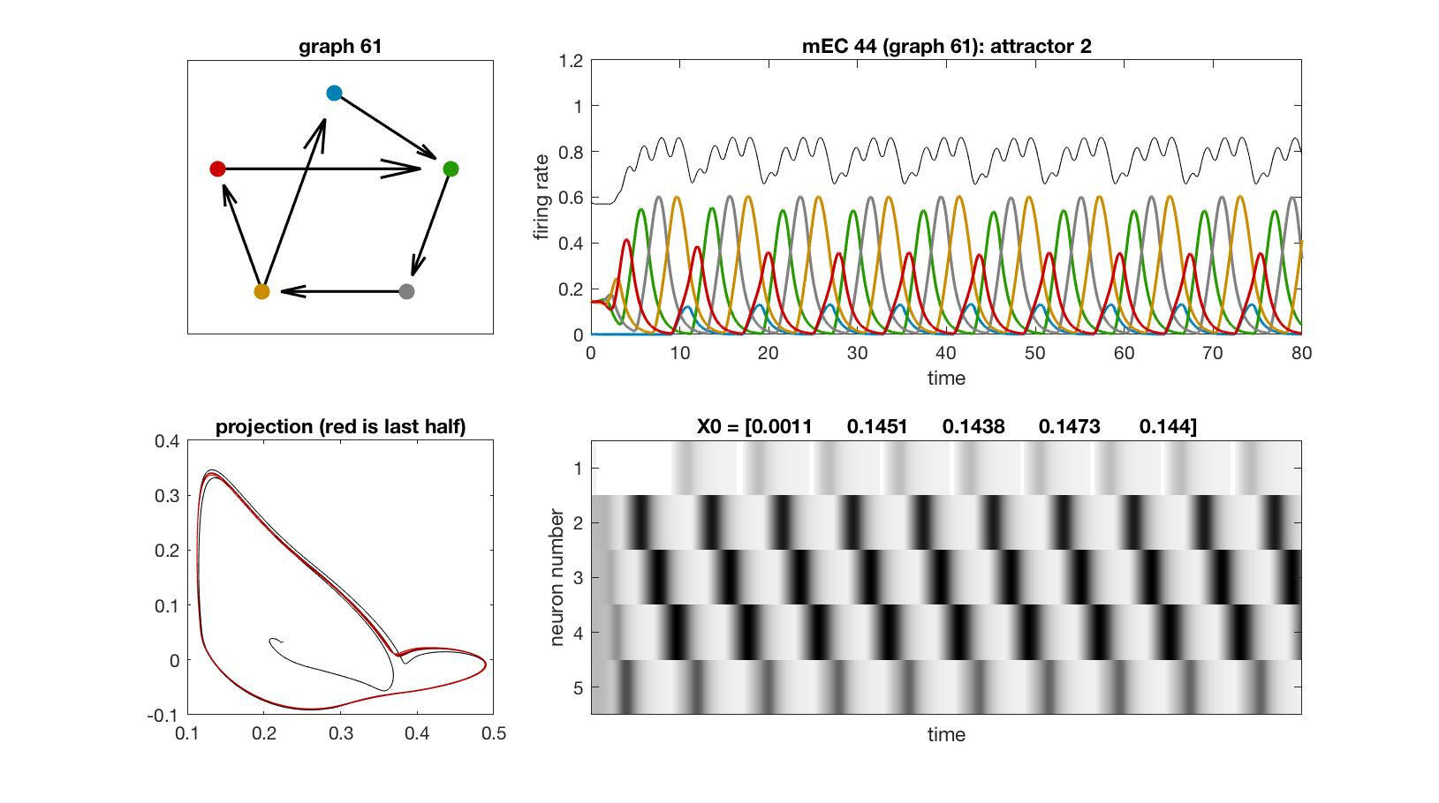
mEC 44

Slide 50
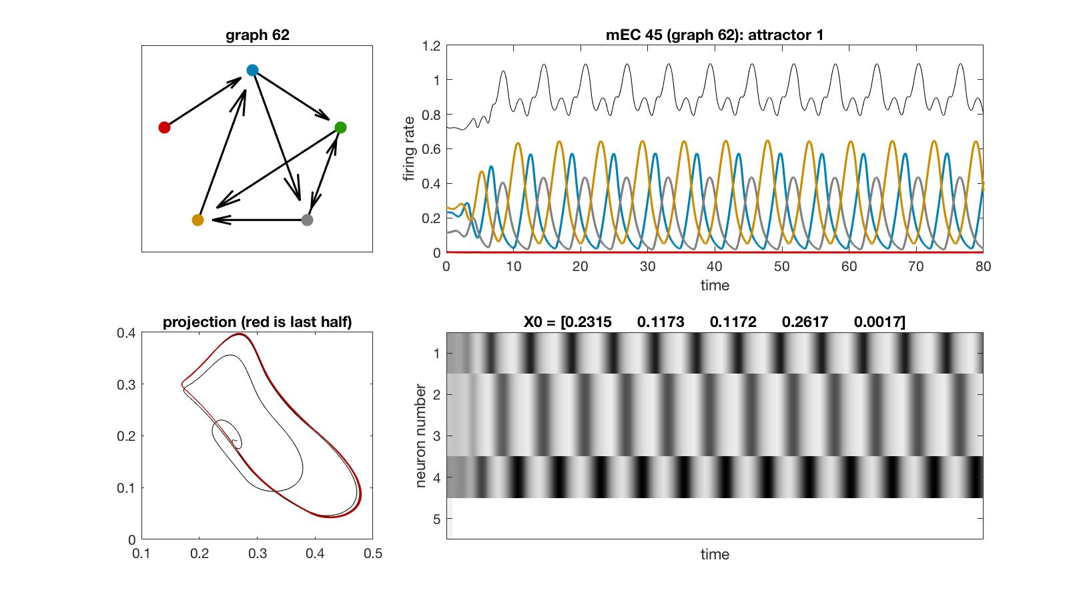
mEC 45

Slide 51
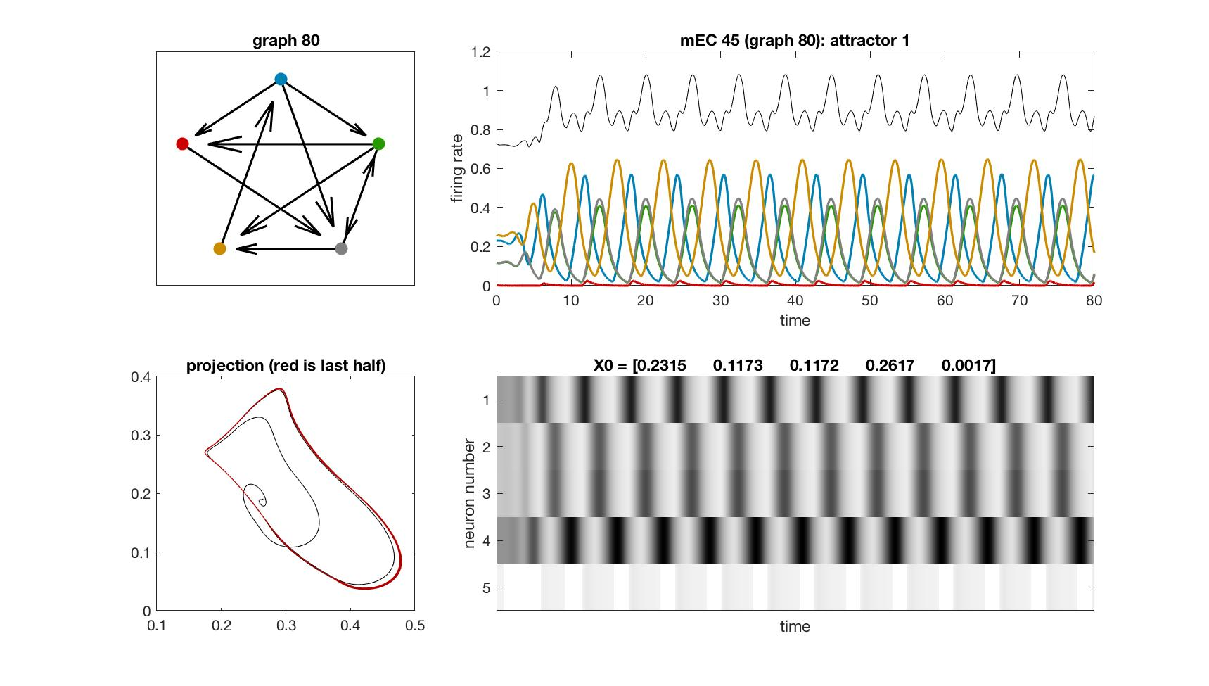
mEC 45

Slide 52
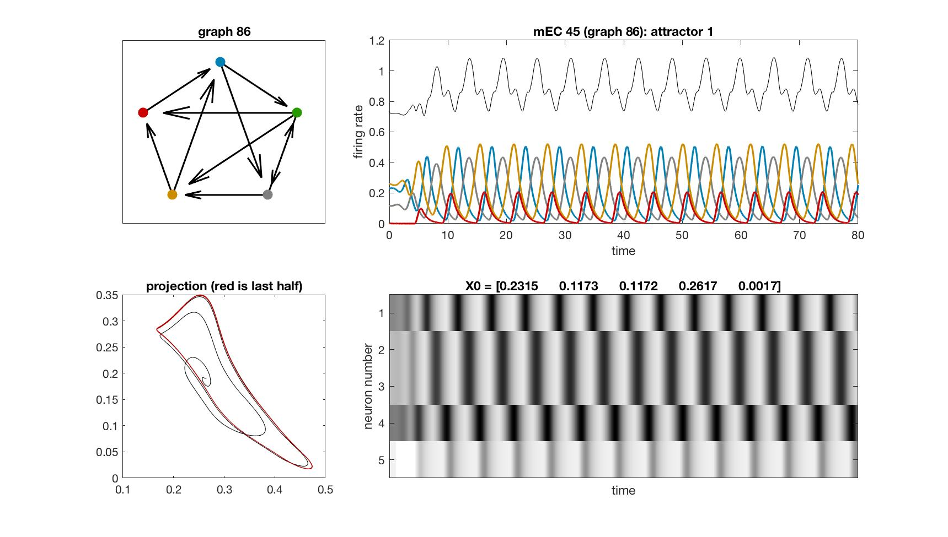
mEC 45

Slide 53
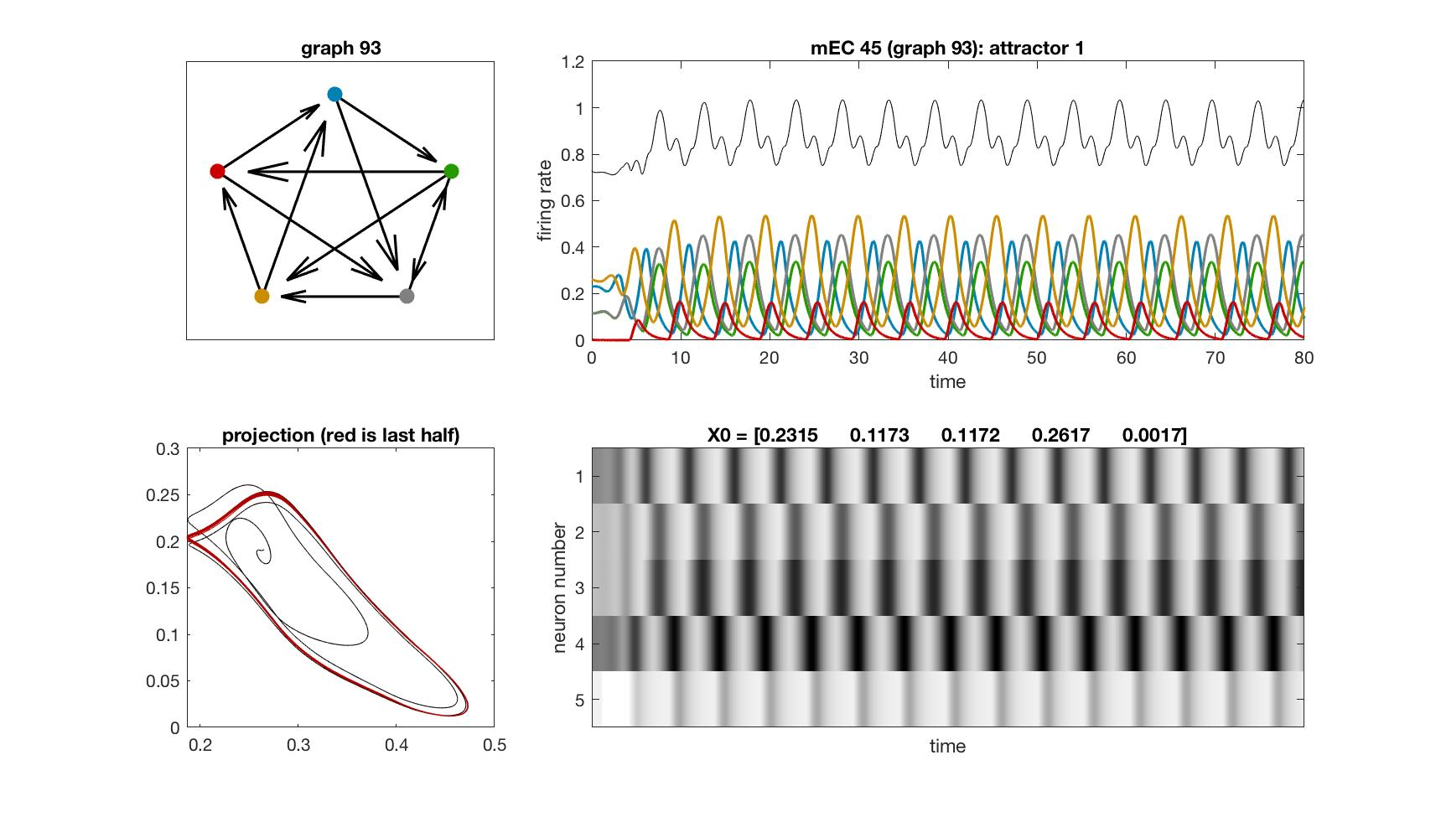
mEC 45

Slide 54
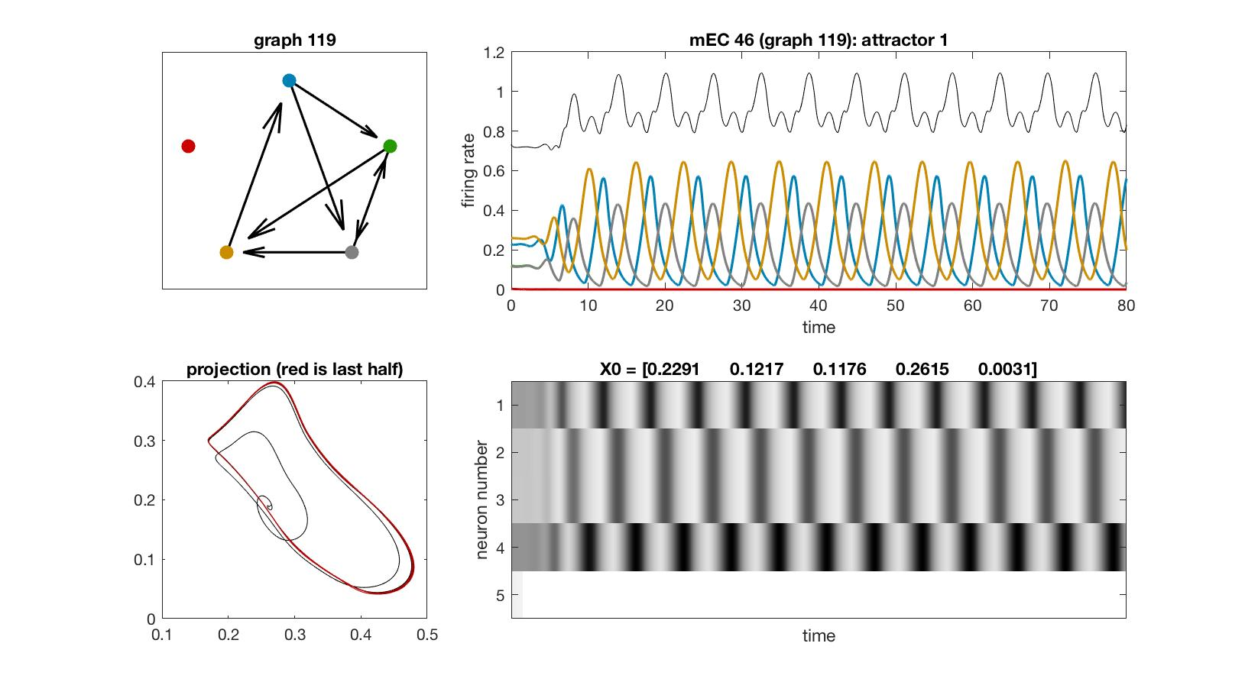
mEC 46

Slide 55
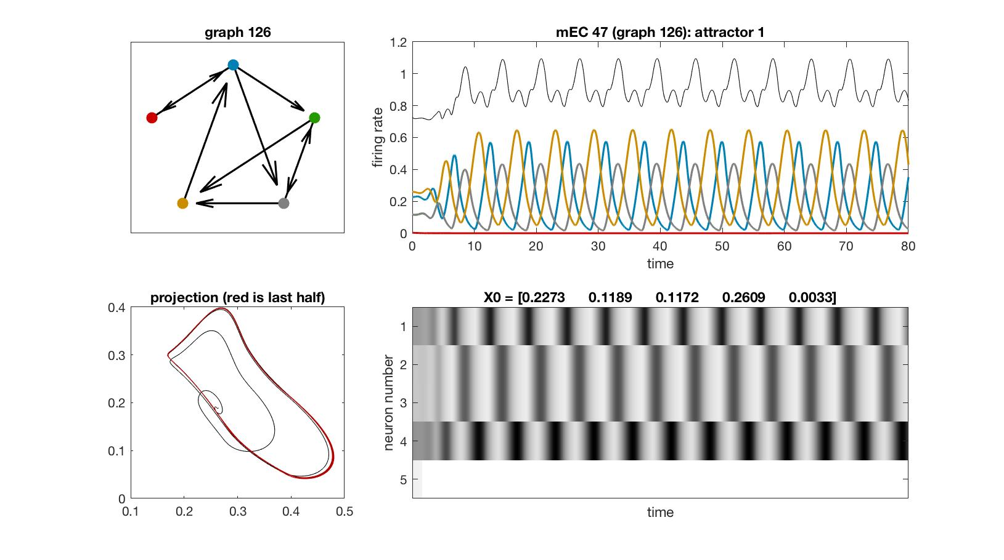
mEC 47

Slide 56
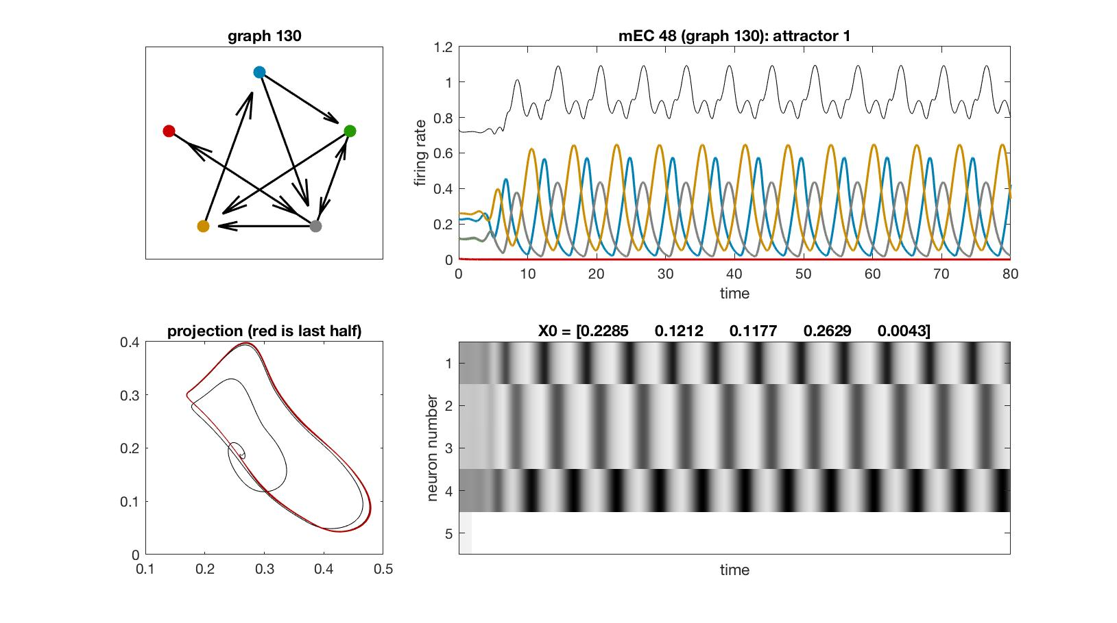
mEC 48

Slide 57
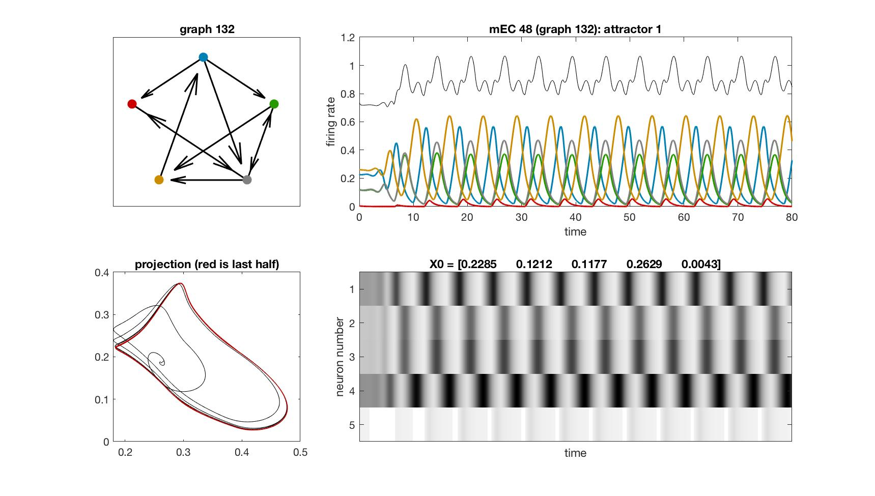
mEC 48

Slide 58

mEC 49

Slide 59

mEC 50

Slide 60

mEC 51

Slide 61

mEC 51

Slide 62

mEC 52

Slide 63

mEC 52

Slide 64

mEC 53

Slide 65

mEC 53

Slide 66

mEC 54

Slide 67

mEC 54

Slide 68

mEC 55

Slide 69

mEC 55

Slide 70

mEC 56

Slide 71

mEC 56

Slide 72

mEC 56

Slide 73

mEC 56

Slide 74

mEC 57

Slide 75

mEC 58

Slide 76

mEC 59

Slide 77

mEC 60

Slide 78

mEC 61

Slide 79

mEC 61

Slide 80

mEC 62

Slide 81

mEC 63

Slide 82

mEC 64

Slide 83

mEC 64

Slide 84

mEC 65

Slide 85

mEC 65

Slide 86

mEC 66

Slide 87

mEC 66

Slide 88

mEC 67

Slide 89

mEC 68

Slide 90

mEC 68

Slide 91

mEC 69

Slide 92

mEC 70

Slide 93

mEC 70

Slide 94

mEC 71

Slide 95

mEC 71

Slide 96

mEC 72

Slide 97

mEC 72

Slide 98

mEC 73

Slide 99

mEC 73

Slide 100

mEC 74

Slide 101

mEC 74

Slide 102

mEC 75

Slide 103

mEC 76

Slide 104

mEC 77

Slide 105

mEC 78

Slide 106

mEC 79

Slide 107

mEC 80

Slide 108

mEC 81

Slide 109

mEC 82

Slide 110

mEC 83

Slide 111

mEC 84

Slide 112

mEC 85

Slide 113

mEC 86

Slide 114

mEC 87

Slide 115

mEC 87

Slide 116

mEC 88

Slide 117

mEC 88

Slide 118

mEC 89

Slide 119

mEC 89

Slide 120

mEC 90

Slide 121

mEC 90

Slide 122

mEC 91

Slide 123

mEC 91

Slide 124

mEC 92

Slide 125

mEC 92

Slide 126

mEC 93

Slide 127

mEC 93

Slide 128

mEC 94

Slide 129

mEC 94

Slide 130

mEC 94

Slide 131

mEC 95

Slide 132

mEC 95

Slide 133

mEC 95

Slide 134

mEC 96

Slide 135

mEC 96

Slide 136

mEC 96

Slide 137

mEC 96

Slide 138

mEC 97

Slide 139

mEC 98

Slide 140

mEC 99

Slide 141

mEC 100

Slide 142

mEC 101

Slide 143

mEC 102

Slide 144

mEC 102

Slide 145

mEC 103

Slide 146

mEC 103

Slide 147
Special attractors for different parameters

Slide 148

Gaudi

Slide 149

quasi-periodic

Slide 150

baby
chaos

